Slide 1
Professor Hussain Rammal
Adelaide Business School
University of Adelaide, Australia
March 2024

Slide 2
Open Science / Open Access Australia
Australia’s Chief Scientist
The key priorities: Quantum Technologies & Open Access
Open Access
Dr Cathy Foley is leading work on a business case for a national strategy for open access to research literature.
Open access will extend the reach and impact of new knowledge arising from research by allowing all researchers, businesses, policy-makers, health practitioners, educators, and the general public to freely access academic journal articles online.
Open access to reliable evidence-based information can help counter misinformation and facilitate innovation across industry sectors and government.
Australia wants to maximise its investment in research by fostering greater knowledge, prosperity, innovation, economic activity and environmental and social understanding and unlock the academic library

Slide 3
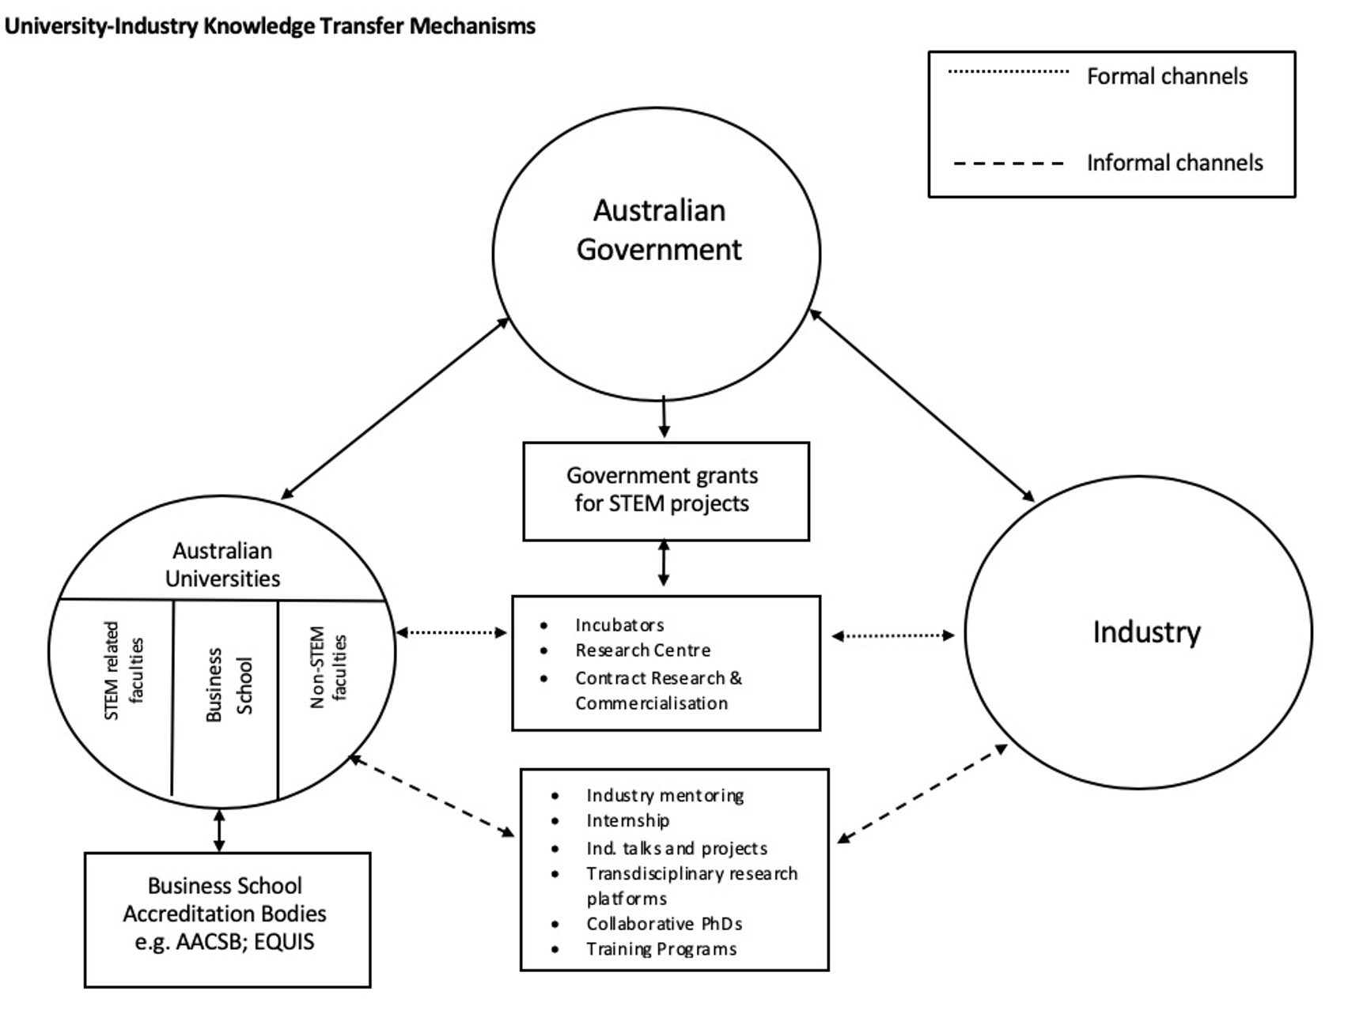

Slide 4
Open Science / Open Access Australia
National Health and Medical Research Council (NHMRC) – grant funding
Our Open Access Policy (the Policy) is underpinned by the principle that publicly-funded research
should be shared openly and at the earliest possible opportunity. Open access is about making
research outputs freely available to use and share, which is distinct from simply 'free to read'.
The NHMRC Open Access Policy applies to all peer-reviewed publications supported in whole or in part by NHMRC. Aim of the policy is to mandate open access sharing and use of publications arising from NHMRC-funded research and to strongly encourage open access to data.
From 1 January 2024 the updated policy applies to all research publications, regardless of when the grant was received. Researchers are encouraged to adhere to the F.A.I.R. (Findable, Accessible, Interoperable and Reusable) Principles and CARE Principles for Indigenous Data Governance
Publications must be made open access immediately upon publication, under a Creative Commons Attribution ‘CC BY’ licence

Slide 5
Open Science / Open Access Australia
Australian Research Council (ARC) – grant funding schemes
The ARC supports the highest-quality fundamental and applied research and research training & encourages national competition across all disciplines outside of clinical and other medical research.
ARC advise the Government on research matters and administer the National Competitive Grants Program (NCGP), delivering around $800 million per year to the most dynamic researchers in Australia.
ARC grants are competitively awarded to individuals, research teams and large-scale centres through 2 broad arms: the Discovery Program, which supports individuals and small teams, and the Linkage Program, which creates links between universities, industry and other partners.
ARC deliver Excellence in Research for Australia (ERA), which assesses research quality within Australia's higher education institutions.
ARC administer the Engagement and Impact Assessment, (EI) which evaluates the engagement of researchers with end-users and shows how universities are translating their research into economic, social, environmental, cultural and other public good.

Slide 6
Open Science / Open Access Australia
Australian Research Data Commons (ARDC) Research Data Australia
The ARDC is Australia’s leading research data infrastructure facility.
An Open Research Toolkit was created by the Open Research Working Group, comprising representatives of the Australasian Research Management Society (ARMS) and the Council of Australian University Librarians (CAUL), with the support from others in the research management community, including the ARDC.
The Toolkit contains information, resources and good practice examples related to all aspects of open research, including policy, governance, pathways and processes.
The ARDC was especially involved in creating the Toolkit sections on FAIR data and FAIR software, pointing to existing policy, guidance and examples. FAIR data and FAIR software are crucial elements in ensuring the research process is open and reproducible.
The ARDC strongly supports the FAIR principles and believes in making data and software ‘Open where possible, only closed where necessary’.

Slide 7
Key points – UofA findability of resources
The University is committed to generating world-class research with tangible outputs of global significance and engaging with the community to make research accessible to more people.
It has an Open Access Policy which mandates the deposit of University Research Outputs.
University of Adelaide supports the findability of resources through its digital repository Adelaide Research & Scholarship and the online repository Figshare. You are encouraged to deposit your work in these systems, or other discipline related repositories, with stable identifiers and metadata.
University of Adelaide encourages researchers to make research data available for re-use whenever possible.
The Research Data and Primary Materials Policy sets out the University's requirements.
Figshare is the University of Adelaide's official data and digital object repository with unlimited local storage. It is available to all current staff and HDR students to upload research data and digital objects.
The University of Adelaide is committed to the sharing and reuse of research data and publications as a signatory to the Sorbonne Declaration . As members of the research community this means aligning your work with the FAIR principles – Findable, Accessible, Interoperable and Reusable.

Slide 8
Key points – UofA Digital Repository
Adelaide Research and Scholarship – University of Adelaide Digital Repository
AR&S is the University of Adelaide’s digital repository. It provides a platform for the University community’s research outputs, access to digital collections and records, and a pathway to fulfilling research grant funding and Open Access requirements: Adelaide Research & Scholarship (AR&S).
The purpose of AR&S is to:
Enable worldwide discovery and open access of research outputs authored by University of Adelaide staff and higher degree research students
Support researchers to comply with the open access requirements of national and international funding bodies
Support researchers to fulfil their obligations in relation to the Australian Code for the Responsible Conduct of Research and the University of Adelaide Open Access Policy
Research outputs are searchable and accessible via AR&S with selected outputs also searchable in Library Search. AR&S is also harvested by external search engines/aggregators (Google Scholar).

Slide 9
Key points – UofA Read & Publish Agreements
Read & Publish Agreements
The University of Adelaide Library is a member of the Council of Australian University Librarians (CAUL) Consortium. CAUL facilitates collaboration between libraries, funders, policy makers, publishers and research communities to respond to the need for continual innovation.
The CAUL Consortium works continuously to negotiate Read & Publish (R&P) agreements, enabling libraries to support students, academics and researchers, with useful scholarly content, and providing authors the opportunity to publish open access immediately on acceptance, and free of any transactional Article Processing Charges (APCs).
Authors from participating institutions are eligible for OA publishing in the included titles under these agreements.
All CAUL Read & Publish agreements are listed on the ESAC registry of Open Access agreements.
Read & Publish agreements provide University of Adelaide students and staff with increased opportunities to publish open access (OA) without paying article processing charges (APCs).
Lists of journal titles covered by each individual Read & Publish agreement are detailed each calendar year (e.g. 2024).

Slide 10
Key points – UofA OERs
Open Educational Resources
Open Educational Resources (OERs) support equitable and inclusive learning and teaching practices by providing course materials that can be freely used, shared, and adapted.
Open resources include a wide range of material that can be freely used in teaching, such as textbooks, lectures, videos, images, question banks, case studies, a whole course or a module, software, data, and statistics.
The main requirement that defines a resource as an OER is that it's been released under the terms of an open licence, e.g. Creative Commons.
To be considered a true OER, the licence should give users the right to retain, reuse, revise, remix, and redistribute the material for educational purposes. From a practical point of view there's lots of material with licences which don't meet all of this criteria but that can still meet teaching needs.

