Slide 1
Open Science experience: Finland
Prof. Jussi Kivistö, Faculty of Management and Business, Tampere University

Slide 2
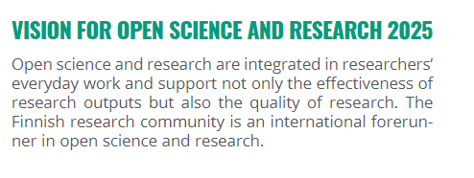
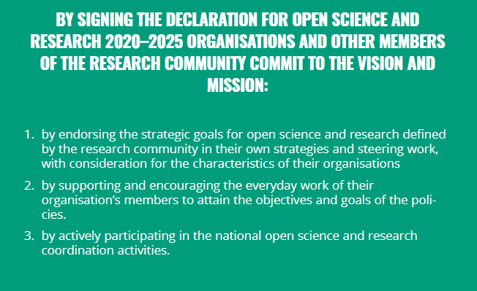
Open Science in Finland
Finland has been very active in promoting Open Science policies and practices domestically and in the European Union
Open Science is an integral part of Finnish higher education and research policy and culture, not an add on
Basic principle is to integrate local, national and international dimensions when developing Open Science
Dimensions:
Culture of open scholarship
Open data
Open access
Open education

Slide 3
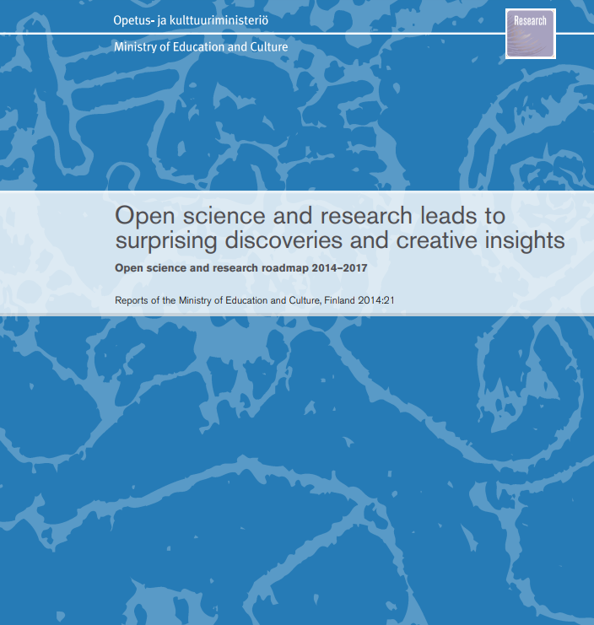

Slide 4
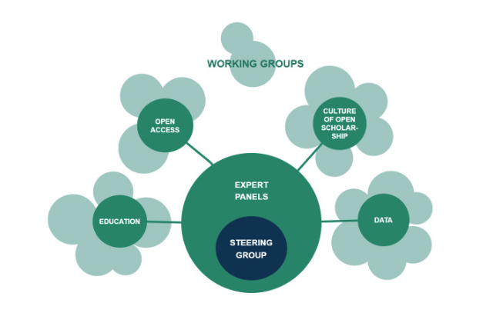
Coordination has been a crucial factor in implementing Open Science
Strongly based on the cooperation of the entire research community and key stakeholders (incl. universities, universities of applied sciences, research institutes, financiers, libraries and archives)
Collaboration between the steering group, expert panels and working groups.
Supported by Secretariat of the National Coordination for Open Science and Research in Finland (OSCAR), with funding from the Ministry of Education and Culture (OKM).

Slide 5
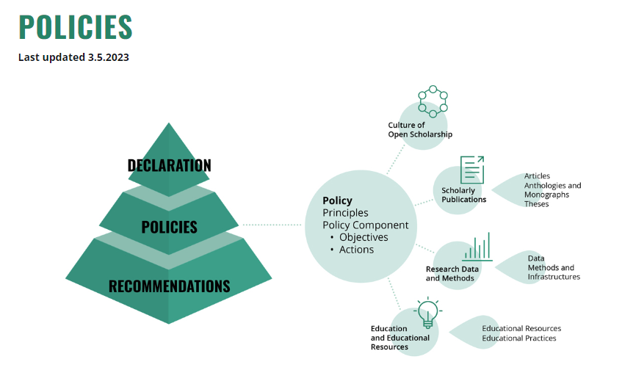

Slide 6
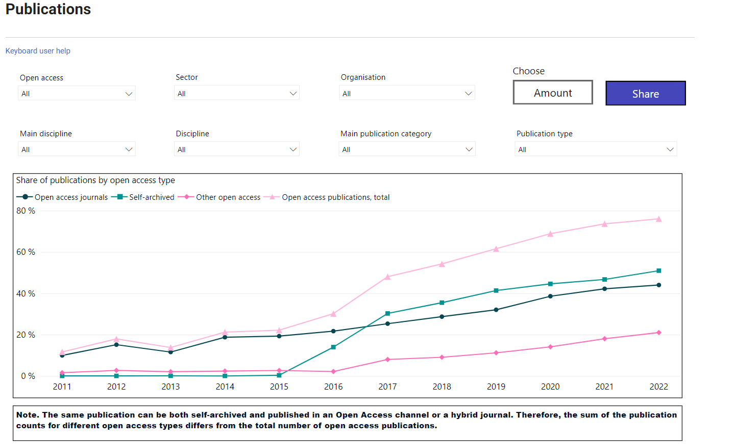
https://research.fi/en/science-innovation-policy/open-science-and-research-indicators

Slide 7
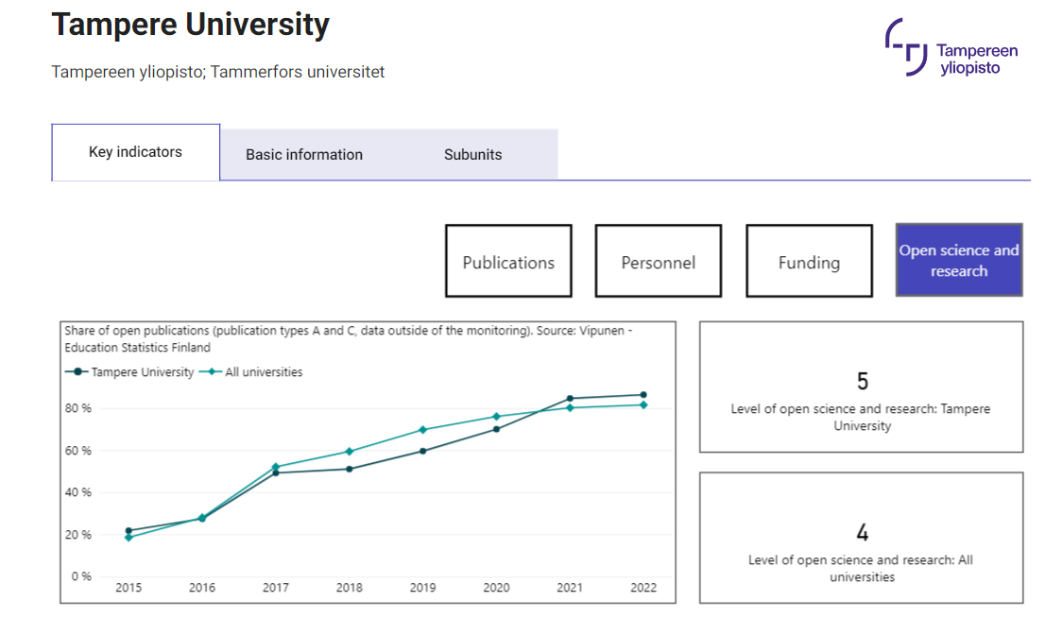
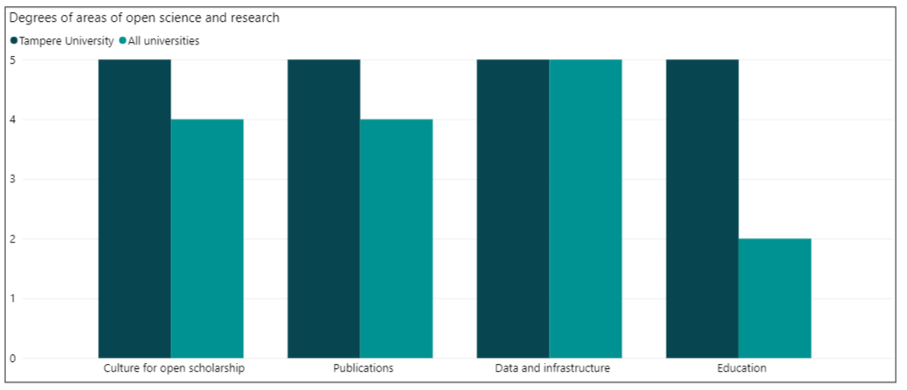

Slide 8
Thank you!

