Slide 1
Open Science tools and practices at Institutional and National Levels
Open Asia March 2024
Prof. Dr. Marjolein Zweekhorst
Dr. Sarju Sing Rai
Notes:
Max. 100 woorden
The VU Amsterdam encourages students and staff to be people with A Broader Mind who expand their perspective academically, develop themselves personally, and engage socially. In order to do so, the VU Amsterdam installed the Broader Mind for Students Programme consisting of the Broader Mind Course (BMC) and Community Service Learning (CSL). In the BMC, bachelor students discuss topics that transcend the confines of their own study programmes. In CSL, students use their academic skills to contribute to societal issues. The VU developed 2 innovative approaches to CSL. In this session, we discuss and reflect on the components of the programme.

Slide 2
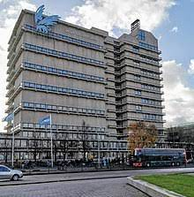
VU University
32.000 students
45 BSc programs
100 MSc programs
4700 staff
31 % female professors
358 phd defences / year

Slide 3
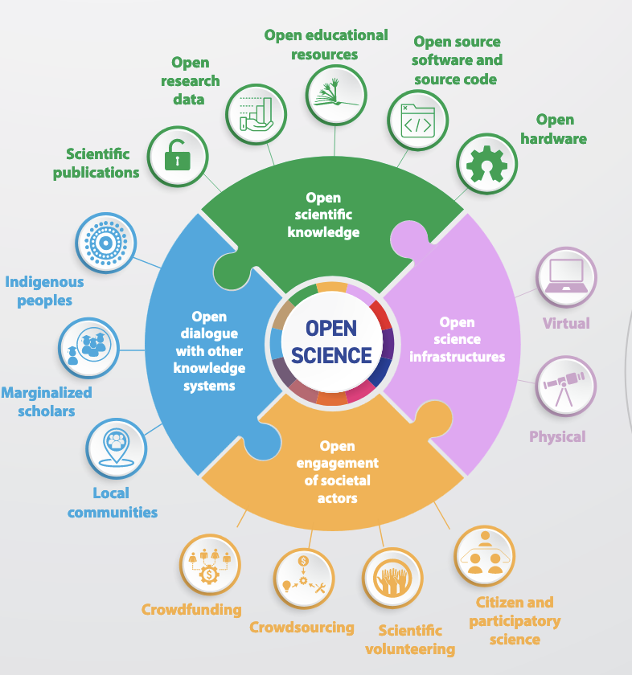
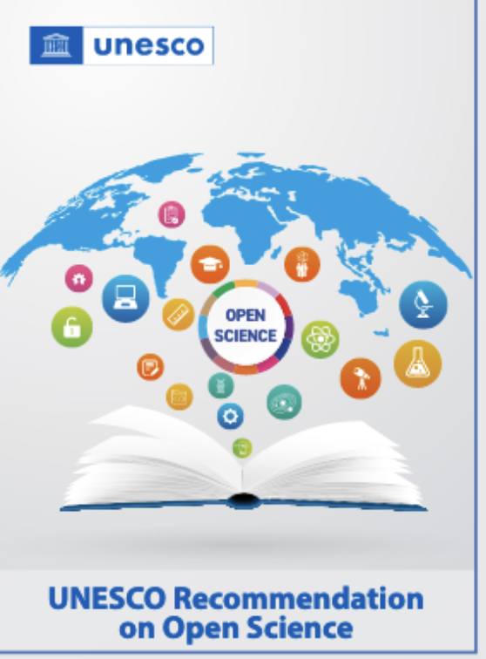
OPEN SCIENCE
Source: Unesco
Understanding open Science 2022
https://doi.org/10.54677/UTCD9302
Notes:
Open Science is the movement that aims at more open and collaborative research practices in which publications, data, software and other types of academic output are shared at the earliest possible stage and made available for reuse. Open Science leads to greater scientific and societal impact.
Open science builds on key pillars:
open scientific knowledge,
open science infrastructures,
science communication,
open engagement of societal actors and open dialogue with other knowledge systems.
Transparency:
Access and Inclusivity
Collaboration and Interdisciplinarity:
Innovation and Discovery:
Public Engagement
Reproducibility and Verifiability:
Resource Optimization
Ethical Considerations:
Global Collaboration:
Addressing Societal Challenges source ChatGPT
Open dialogue with other knowledge systems refers to the dialogue between different knowledge holders, that recognizes the richness of diverse knowledge systems and epistemologies and diversity of knowledge producers, in line with the 2001 UNESCO Universal Declaration on Cultural Diversity. Open dialogue aims to:❚promote the inclusion of knowledge from traditionally marginalized scholars and ❚enhance:»inter-relationships and complementarities between diverse epistemologies, »adherence to international human rights norms and standards, »respect for knowledge sovereignty and governance, and »recognition of the rights of knowledge holders to receive a fair and equitable share of benefits that may arise from the use of their knowledge. In particular, links with indigenous knowledge systems must be built in line with the 2007 United Nations Declaration on the Rights of Indigenous Peoples and principles for Indigenous Data Governance, such as the CARE (Collective Benefit, Authority to Control, Responsibility and Ethics) data principles. Such efforts acknowledge the rights of indigenous peoples and local communities to govern and make decisions on the custodianship, ownership and administration of data on traditional knowledge and on their lands and resources.

Slide 4
SCIENCE SHOPS NATIONAL LEVEL
The science-shop model was initiated in the Netherlands in the 1970s,
and spread throughout Europe during the 1980s,
The crucial idea behind the science shops:
involves a working relationship between knowledge-producing institutions, such as universities, and citizen groups that need answers to relevant questions.
Accomplishing active collaboration in research, as well as providing such groups with access to the university and its facilities (Bunders & Leydesdorff, 1987).

Slide 5
SCIENCE SHOPS NATIONAL LEVEL 2
Community Based Participatory research
Community based education
Public engagement
Community based curriculum

Slide 6
INSTITUTIONAL LEVEL
The VU Amsterdam wants to offer its students the opportunity to develop more broadly, from an academic, personal, and social perspective: to equip students to be successful and to play a meaningful part in this world.
=> Various projects that contribute to this aim !
Notes:
Ik zal deze nog even update naar nieuwe voorbeelden
6

Slide 7
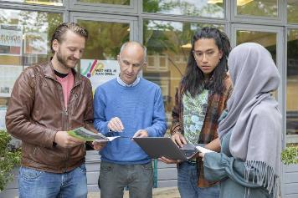
A BROADER MIND FOR STUDENTS: COMMUNITY SERVICE LEARNING
With Community Service Learning, students use their academic knowledge and skills to contribute to solving societal problems. By doing so, students are working closely together with societal partners. The reciprocity of CSL is actuated in academic reflection before, during and after the educational activity. ​

Slide 8
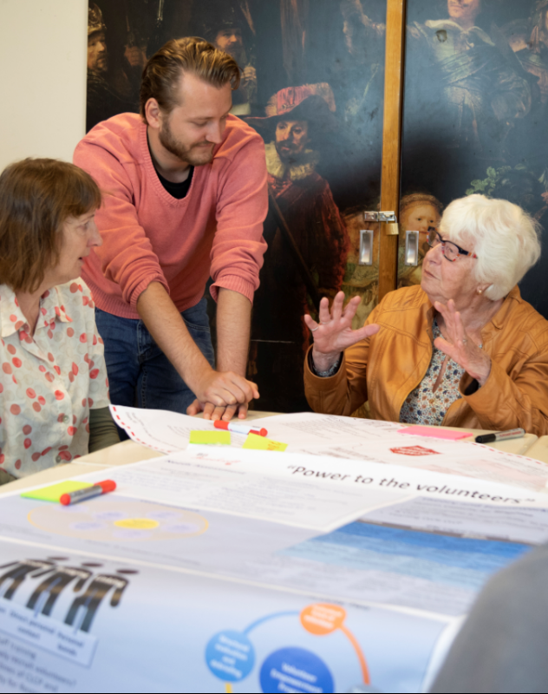
community service learning
Lecturer
Interactive approaches
Reciprocity
Reflection
Student
Academic
Skills
Societal partner
Societal challenges
Notes:
“With Community Service Learning (CSL) students use their academic knowledge and skills to contribute to solving societal problems. By doing so, students are closely working together with societal partners. Reciprocity is emerging here. An important feature of CSL is academic reflection before, during and after the educational activity. ” Reciprocity (co-creation / co-production) between the society partner and the academic partner is conditional for CSL.
8

Slide 9
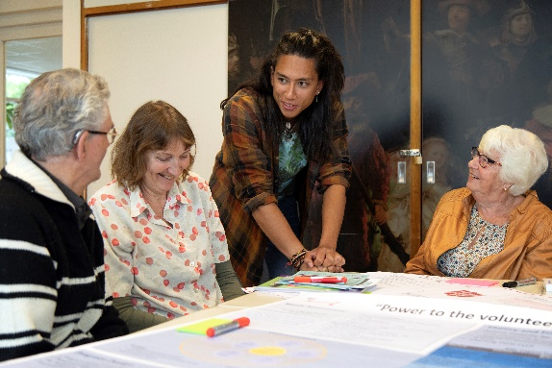
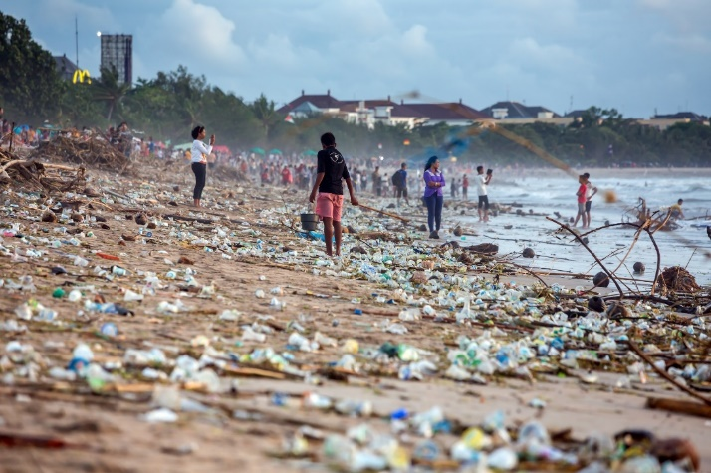
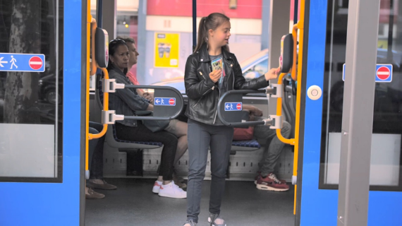
STRATEGY DEVELOPMENT: CSL FOR ADDRESSING COMPLEX PROBLEMS
The thematic CSL approach: Multiple courses and internships from various disciplines to address a complex societal issue
Loneliness
Sustainability
Inclusive cities
Notes:
One of the strategies we have developed within the VU university to deal with this issue is the thematic CSL approach in which multiple courses and internships from various diciplines are clustered to adress one complex societal issue.
We are currently working on three themes; loneliness, sustainability and inclusive cities i will very briefly ouline the approach and then again relte them to the points within the guidelines of instuttionalzing engaged education.

Slide 10
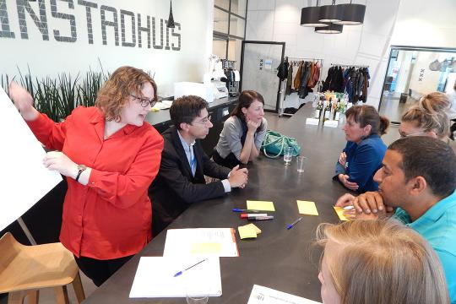
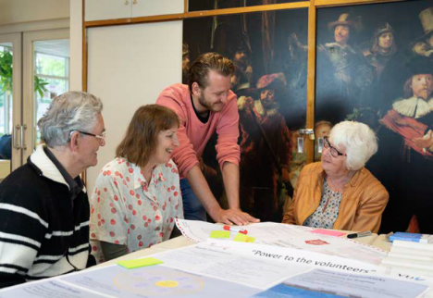
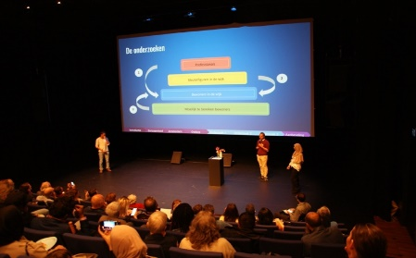
CONTINUOUS PROCESS WITHIN THE THEMATIC APPROACH
Identification of the issue
Doing research
New opportunities
Giving back
Notes:
So this is how the process looks; together with the community we identfy pressing societal issues, than we match multiple courses and internships that aim to address the issue following a continous cation research approach of match and co design and then the results re also ‘given’ back to the communities and the parners and then often new questions arise as a result of this that might be direct input for other courses or give rise the idetifction of new issues..

Slide 11
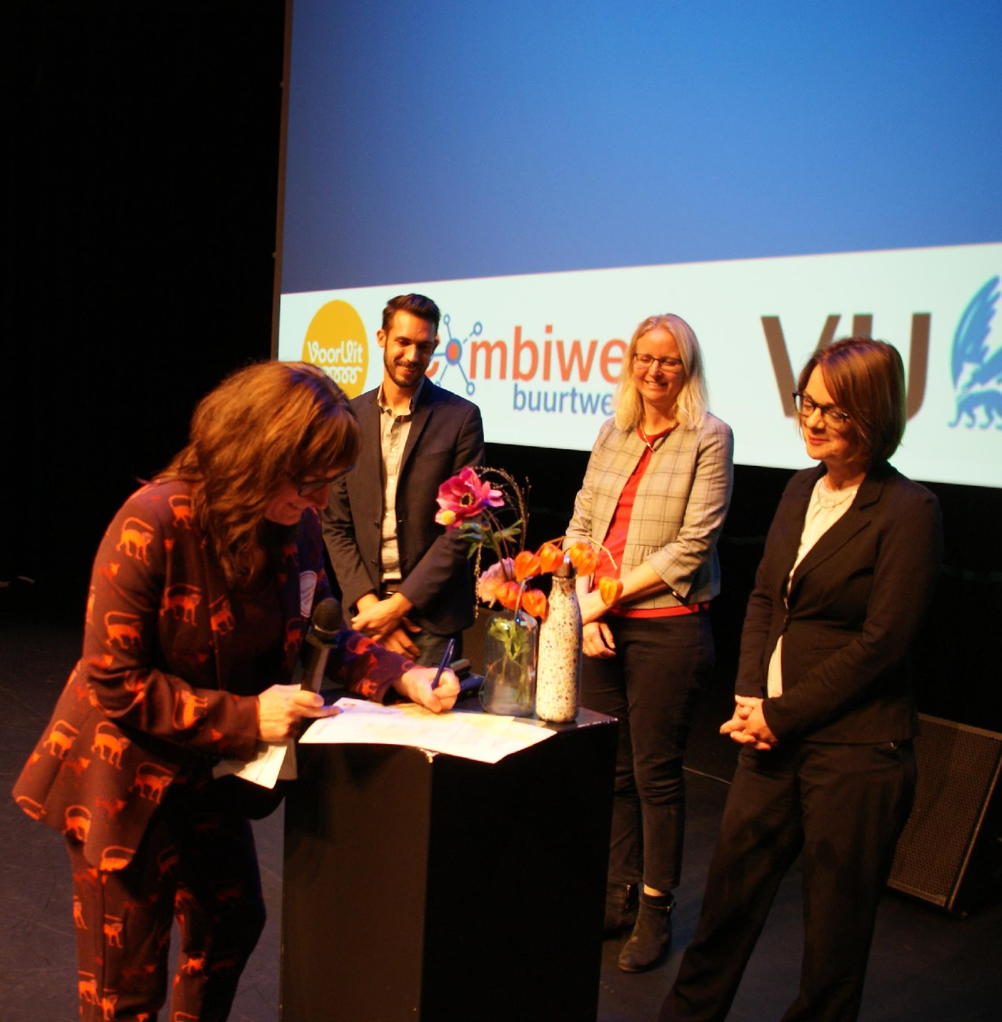
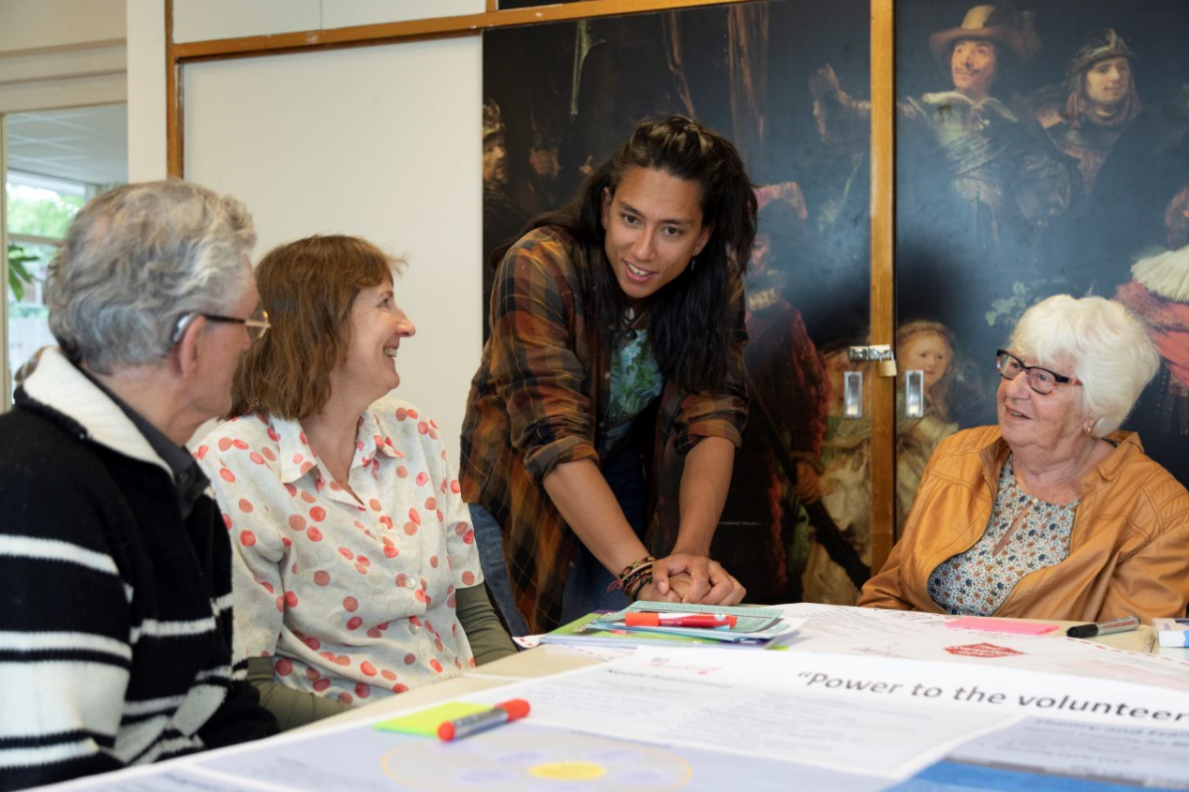
THEMATIC APPROACH (EXAMPLE: LONELINESS)
Analysis of Governmental policy (MSc)
Geriatrics BSc
Health communi-cation BSc
Internship Sociology BSc (5x)
Internship Management Policy and Entrepreneur-
ship MSc (3x)
Analysis of Governmental policy (MSc)
Geriatrics BSc
Internship Sociology BSc (4x)
Internship Management Policy and Entrepreneurship MSc (3x)
Internship Theology MSc (1x)
Kennisalliantie eenzaamheid:
Analysis of Governmental policy (MSc)
Therapy in theory and practice (MSc)
Cases in beleid –en organisatie vraagstukken (MSc)
Urban studies
(BSc)
Document Design (BSc)
Governing Global Challenges (BSc)
Research project (BSc 1x)
Notes:
No need to conider the figure in detail but just to show how this can look like; so various courses but als intersnips are clusetered to adress one issue in this case lonliness and within this process the studnets build as much as possible on eachothers outcommes

Slide 12
iCSL2 : Addressing Challenges through Transdisciplinary Research
SUPERVISOR FROM URV DOING RESEARCH ON COVID-19
SUPERVISOR FROM VUA DOING RESEARCH ON COVID-19
PSYCHOLOGY
STUDENT FROM VUA
ENVIRONMENT & RESOURCE MANAGEMENT
HEALTH
STUDENT FROM URV
STUDENT FROM VUA
SUPERVISOR FROM UP DOING RESEARCH ON COVID-19
CULTURE, ORGANIZATION AND MANAGEMENT
z
ECONOMICS & PUBLIC POLICY
STUDENT FROM UP
SUPERVISOR FROM UINN DOING RESEARCH ON COVID-19
STUDENT FROM UInn
SUPERVISOR FROM UNINA DOING RESEARCH ON COVID-19
BIOLOGY
STUDENT FROM UNINA
Start building a collaborative network of AURORA students & supervisors
Notes:
12

Slide 13
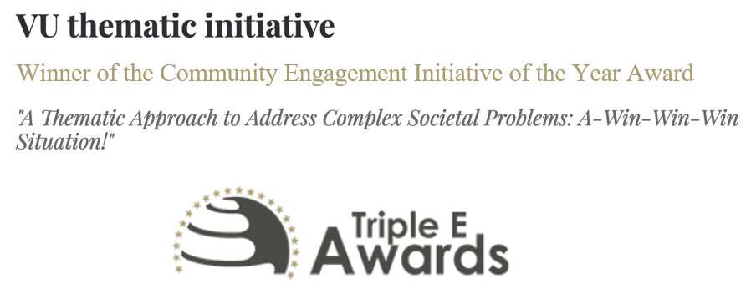
BENEFITS OF THE THEMATIC APPROACH LINKED TO GUIDELINES
‘With their Thematic Approach, our Community Service Learning (CSL) team has won the 'Community Engagement Initiative of the Year', organized by the European Triple E Awards’ (VU zine edition 27, 2022)
Notes:
So now i would like to highlihed the benefits of this approach as we have experienced this in relation to the guidelines;
1. The approach provides incestives; as we have been nomintaion for innovation price within the Vu and recently winner of the community engagment iniative of the triplle e awards; this is also for the partners that we work with postive and as you see it was also picked up by the VU zine (or university wide newsletter)
5. There are permenet faculty opperunties as they can alsoways join the ongaing themes we are working on; we alsoready have the ppartnernetwork and questions identified
6. There are incentives as we see increased motivation of teachers and studnets as they can contribute to a larger pressing issue..

Slide 14
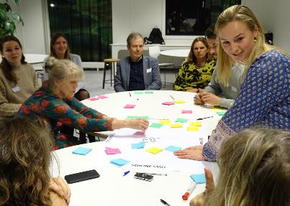
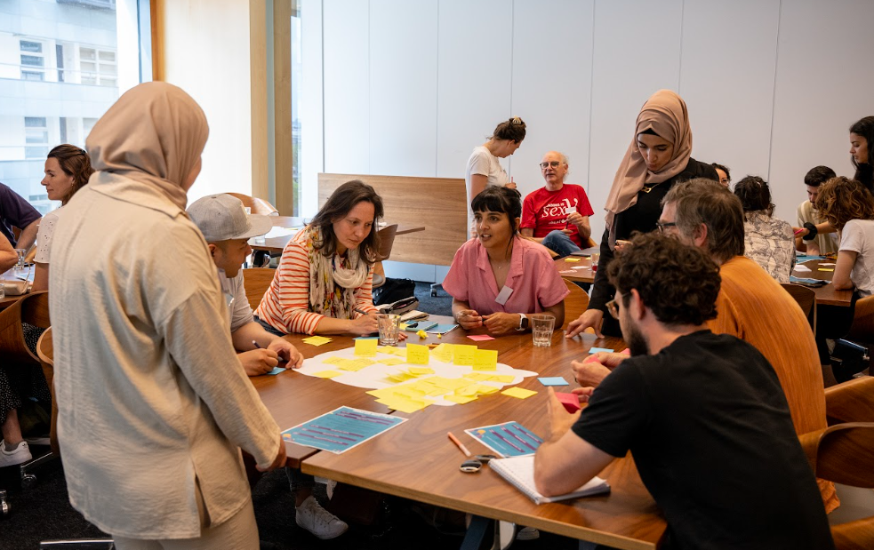
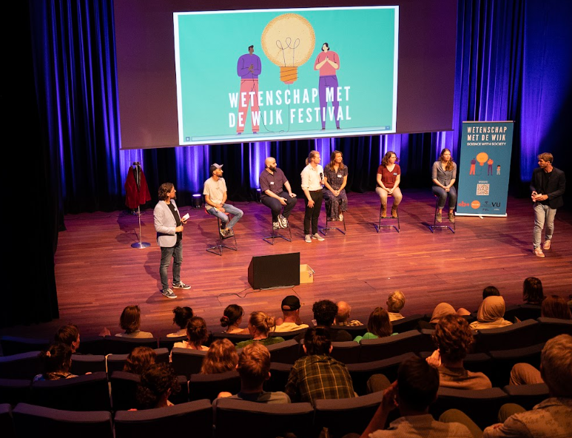
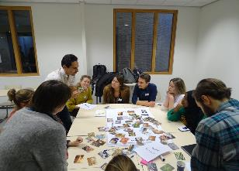
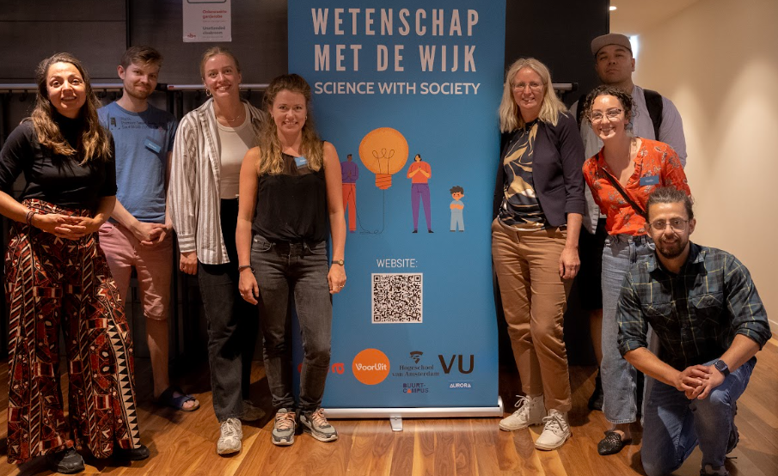
IMPRESSION STUDENTS WORKING WITH COMMUNITIES
14

Slide 15
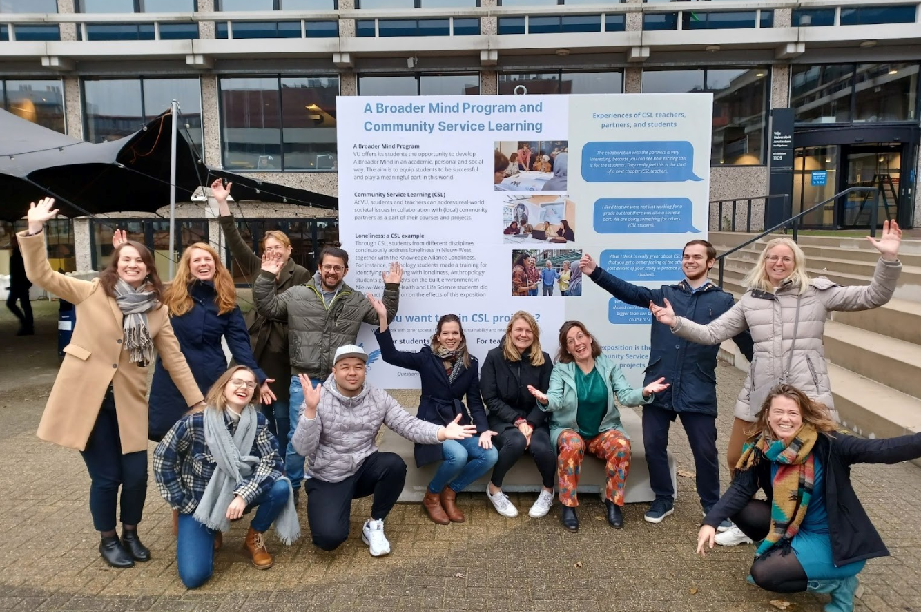
THANK YOU FOR YOUR ATTENTION ]
Also on behalf of the entire VU BM-CSL-research team
For questions and suggestion on CSL please contact
CSL@vu.nl
Notes:
I gave this talk but just to show that this is not just me but there if a whole team working on this.

