Slide 1
National Policy Development on Open science
- Indian journey
Dr. Sharad Mhaiskar
PVC, NMIMS
sharad.mhaiskar@nmims.edu
1

Slide 2
In this presentation….
About NMIMS
Research & Open Science landscape in India – bird’s view
“Erasmus- Open Asia” to benefit India, region and the world
Concluding remarks
2

Slide 3
About NMIMS
NMIMS declared a deemed-to-be university in 2003 – earlier a management school established in 1981- Trust established in 1934
Multi campus, multi domain university with 17 schools - 6 campuses
Strong industry connect , relevant curricula, placement records and standing – preferred destination
Ranked 47th in NIRF (national ranking), AACSB accredited management programs, ABET accredited programs (5) –with “Next General Review” status - national accreditation – NAAC & NBA
NMIMS stands on 4 building blocks of Knowledge creation, Teaching excellence, Managing stakeholder expectations and Perception –
Research given high priority and focus – several initiatives, budget allocation, incentives, innovation and startup opportunities, EU Open Asia project fits in NMIMS vision
3

Slide 4
Research focus in India
Federal budget 2023-24, the GoI earmarked Rs 16,361 crore ( $ 163/ Euro 182 billion) Ministry of Science and Technology - about 0.36 % of the overall budget- nominal increase of ~15% from previous year i.e. (~ Rs 14,217 crore/ $142 / Euro 158 billion)
Gross Expenditure on R & D (GERD per capita ) needs to increase ($ 43.41 India /$ 63 Mexico / $ 1777 USA)
India needs to boost GERD if it wants to become a 5 trillion dollar economy, which ever way you look at, GERD per capita or % of GDP - the inputs need to drastically increase to say 2.5 % of GDP
Where will the resources come from ? Is R & D a priority when citizens struggle for basic needs- not a straight forward answer
Is there a shortage of talent ?– Not at all- Public sector alone cannot contribute – In other countries 70- 80 % comes from Private sector - 36 % from private sector in India – about 56 % from Govt.
Dr. Ravindra Singh- March 2023
4

Slide 5
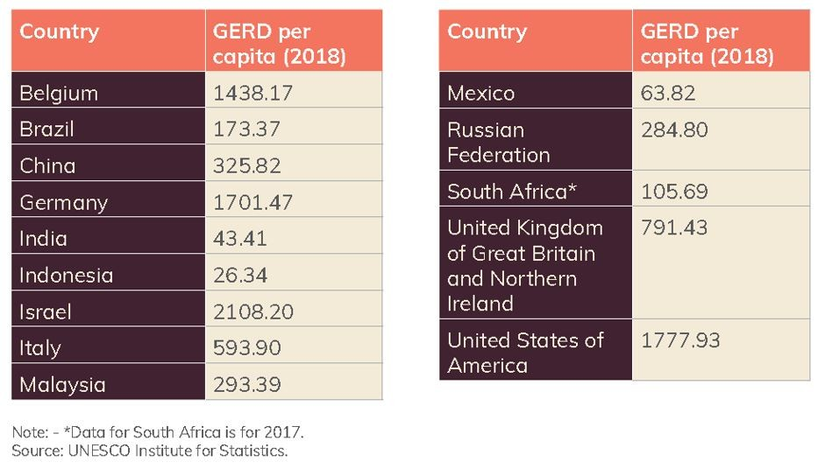
Gross Expenditure on R & D (GERD)
Dr. Ravindra Singh- March 2023
5

Slide 6
Research in India
Prime Minister ’s push for research over last 10 years
1100 odd universities growing at a CAGR of 5.3 %, focus on research & innovation, startup culture , patenting , technology transfer ….
Rise in patents (CAGR of 3.6 %), publications , Ph.D. etc. on rise IPR is bound to improve
India's research output was the fourth highest worldwide (1.3 million between 2017-22 ) , growth by 54 % compared to global average of 22 % (Hemali Chappia- ToI , March ,2023)
With scarcity of funding for R & D at Govt. level, Private R & D funding needs to improve
Resources have to become more accessible – Open science , sharing of knowledge can prove to be of immense help
Dr. Ravindra Singh- March 2023
6

Slide 7
OS in India
UNESCO recommendations (2021 – draft -2019)
DBT- DST – 2014 - STIP - Draft Policy 2020
Status today, Where do we see the movement going
7

Slide 8
UNESCO recommendations
UNESCO recommendations adopted by 193 countries in November 2021 (discussion initiated in 2019….)
Access to scientific knowledge as open as possible but restricted to protect human rights, confidentiality, intellectual property rights, personal information etc.
Further member states were expected to develop national laws and practices - leading to internationally accepted definition
Balanced, multi-stakeholder views, inclusive and transparent consultative process
8

Slide 9
DBT-DST Open Access Policy highlights -2014
DBT and DST fund research projects and expects high quality research
Intrinsic merit of work given weightage during funding decisions
Use of impact factor of the journal not a measure of quality of research article or for hiring, promotion etc.
Maximizing the distribution , depositing the articles in institutional repository is the most effective way in ensuring that research can be built on
Institutional repository (IR) is recommended, central harvester set up
IR should ensure published articles with an embargo of not more than 6 months – publishers be made aware of this fact
9

Slide 10
5th Science , Technology & Innovation Policy Draft – Dec. 2020
Earlier four policies in 1958, 1983, 2003, 2013
5th STI policy to boost short, medium & long term mission mode projects
Draft policy revolves around decentralized , evidence based, bottom-up, experts driven and inclusive approach
First chapter devoted to Open science
Promotes Open Science where public will have the right to access research funded by Federal or State govts.
Focuses on 10 different points
10

Slide 11
Focus of 5th STIP
National STI observatory (repository), IND STA (archive -dedicated portal)
Open Data Policy (public funded projects), Open Access (full manuscripts)
One Nation One subscription (GoI to negotiate), Indian journals (popularize)
Research facilities sharing , Open educational resources
Libraries, Learning spaces
Draft Policy yet to be accepted formally
11

Slide 12
EU OS Asia - Fit to NMIMS
Research a very important parameter in ranking, accreditation ..
Budget on Research resources – library, online journals, data…
VC already showcased NMIMS vision for research
OS – Asia will support the vision in a big way
12

Slide 13
EU - OS Asia project
Need to enhance research outcomes and impact- imperative to utilize resources optimally for the society and country
Erasmus Open Asia project is the right choice for India
It has three important elements
- Building OS infrastructure
- Capacity building
- Guidance to policy and strategy
The three year project will benefit partners, India, the Asian region and eventually impact global collaboration
13

Slide 14
….. In this presentation
Brief background of NMIMS, Research status of India
UNESCO, DBT- DST recommendations overview
5th STI policy draft -2020
Erasmus Open Asia project’s likely impact on stakeholders
Let us collaborate and unlock the power of knowledge
14

Slide 15
Discussion !
15

