Slide 1
National action plan for open science – Slovenia prepared for OpenAsia, Forum 1, Mumbay 21 03 2024 dr Nada Trunk Širca Špela Dermol, mag
This presentation is adapted by ISSBS team (dr Nada Trunk Širca)
from presentation of dr Ana Slavec, University of Primorska - Koper, 15. 2. 2024

Slide 2
How to define open science (OS)?
The story of the blind men and the elephant. The moral of the parable is that humans have a tendency to claim absolute truth based on their limited, subjective experience (knowledge, data) as they ignore other people's limited, subjective experiences (…) which may be equally true.
Image source: openclipart

Slide 3
Legislative history of OS in Slovenia
Resolution on the national research and development program 2011-2020
National strategy of open access to scientific publications and research data in Slovenia 2015-2020
2021 Scientific research and innovation strategy act (ZZrID)
Resolution on the Slovenian scientific research and innovation strategy 2030
Regulation on conducting scientific research according to the principles of open science 2023
Open science action plan (31 May 2023)

Slide 4
6 actions of the OS action plan
Internationally compliant national open science ecosystem
Evaluation of scientific research activity in accordance with the principles of OS
Compliance of scientific research results with FAIR principles and openness
National open science community
Civic science
Open access national scientific publishing

Slide 5
1. Internationally compliant national OS ecosystem
Adapting the national open science ecosystem to work according to the principles of open science
Adaptation of the public research organizations to operate according to the principles of open science
Infrastructure for open science
Knowledge and skills for open science

Slide 6
Adaptation of public research organizations to the operation according to the principles of OS
The SPOZNAJ project is a consortium of 20 Slovenian public research organizations and the Central Technical Library of the University of Ljubljana
The partners will adapt their operations to the principles of open science
This will contribute to awareness and understanding of the importance of open science and sharing results in accordance with the FAIR principles
The project is part of the recovery and resilience plan and runs from 2023 to 2026

Slide 7
Infrastructure for open science
The library catalog system Cooperative Online Bibliographic System and Services (COBISS) connects Slovenian libraries into a unified Slovenian library information system and is managed by the Institute of Information Sciences (IZUM).
The Slovenian National Supercomputer Network (SLING) is a consortium for the development of network computing and management of supercomputer infrastructures in Slovenia, managed by the Academic and Research Network of Slovenia (ARNES).
European open science cloud. EOSC is a pan-European research data platform that connects existing infrastructures and projects in the field and serves as a virtual community of data producers and users. Is non-profit organization. It is described as a catalog of various providers, services and resources for the researcher.

Slide 8
2. Evaluation of scientific research activity in accordance with the principles of OS
Amendments and additions to ARIS regulations
Amendments and additions to NAKVIS regulations
Amendments and additions to public research organizations regulations/criteria
Incentives for engagement in the field of open science
Participation in ERA and EHEA activities in the field of reform of the evaluation of scientific research activity in accordance with the principles of open science

Slide 9
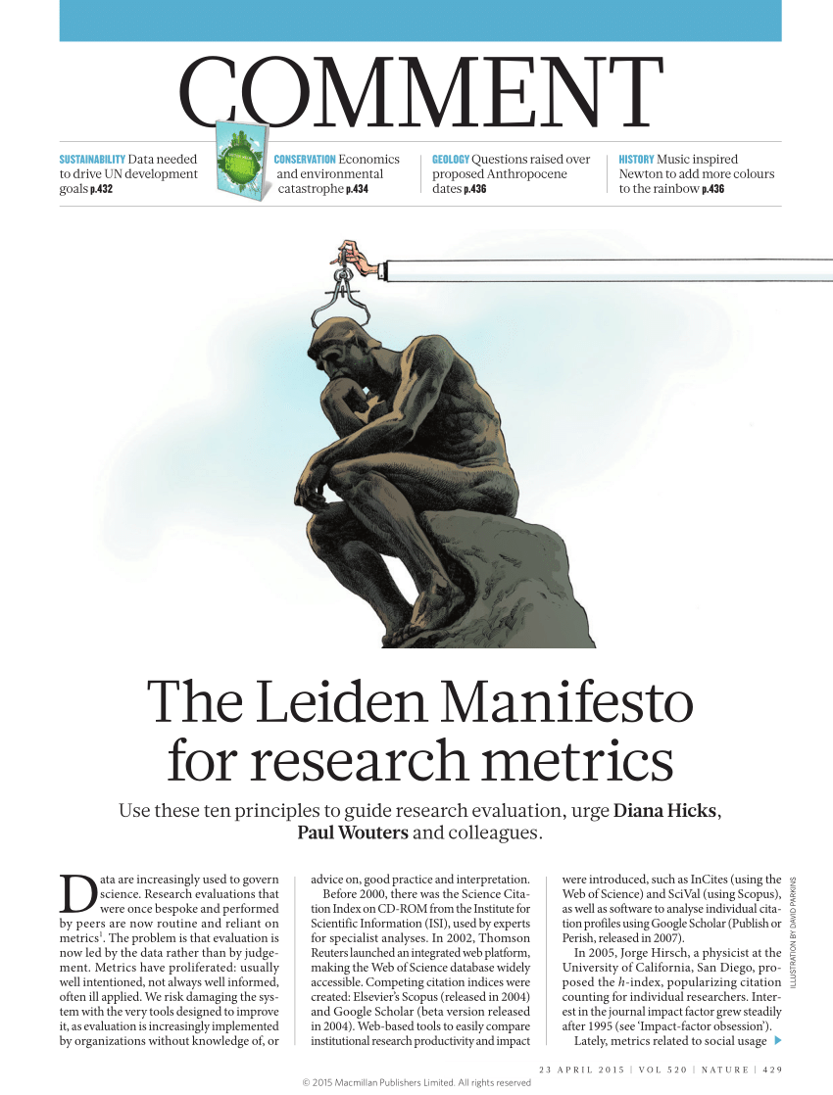
Initiatives to change the evaluation of research activity
The San Francisco Declaration on the Evaluation of Research (DORA) advocates evaluating research based on its content and quality rather than relying solely on metrics
The Leiden manifesto provides guidelines for the responsible use of quantitative indicators in research evaluation
The Coalition for the Advancement of Research Assessment (CoARA) is a collective direction for change in the practice of research assessment, researchers and research organizations

Slide 10
3. Compliance of scientific research results with FAIR principles and openness
Incentives to support the introduction of open science
Open access to peer-reviewed scientific publications/research results
Open research data
Other open digital objects

Slide 11
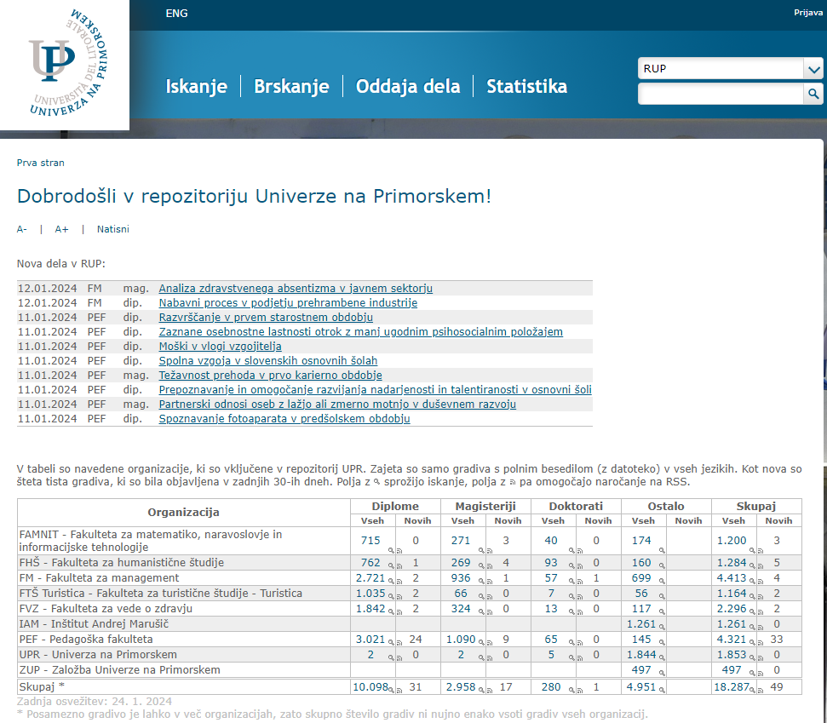
Different types of research data repositories

Slide 12
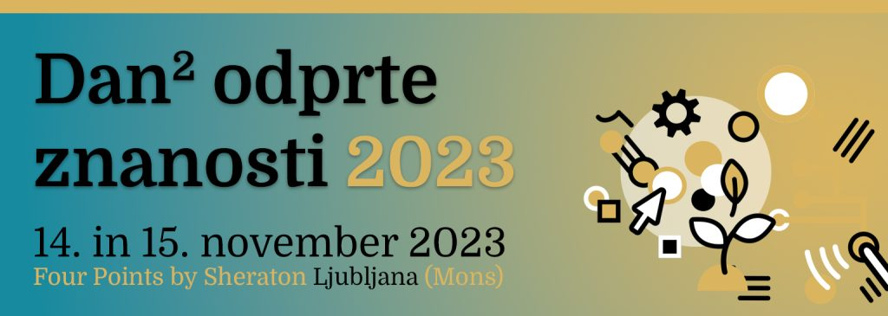
4. National community for OS
Identification of open science stakeholders
Establishment of the Slovenian community of open science – SSOZ
Permanent professional and administrative support of SSOZ
Slovenian OS community

Slide 13
5. Civic science
Civic science observatory
Incentives for the inclusion of citizen science in the scientific research process

Slide 14
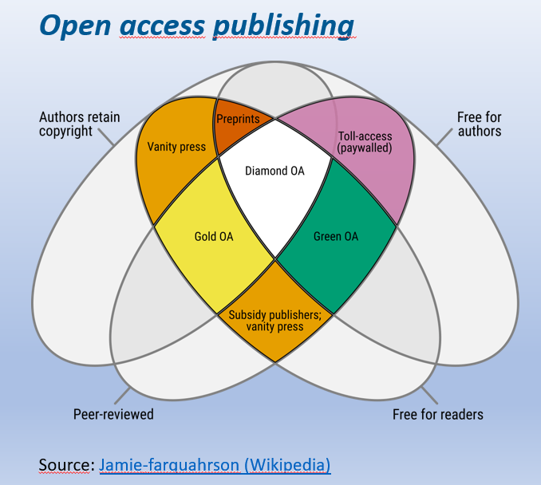
6. Open access national scientific publishing
National contact point for scientific publishing
Establishment of a Slovenian network of scientific publishers
Implementing diamond open access in national scientific publishing
Development and innovation in the field of national scientific publishing
Changes and additions to ARIS regulations in the field of publishing

Slide 15
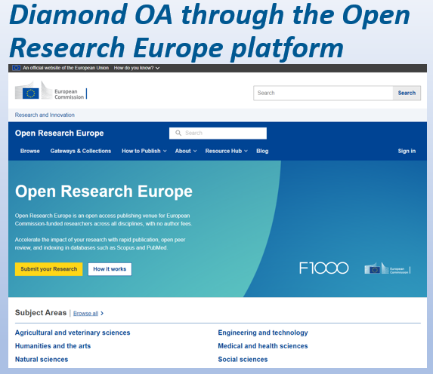
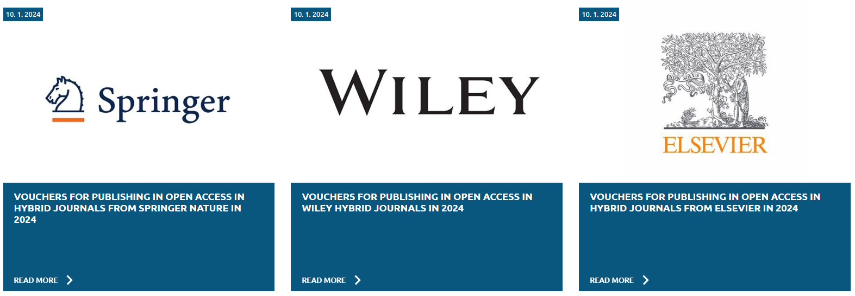
Vouchers for open access costs

Slide 16
Thank you for your attention.

