Slide 1
Open Science in the UK
Practices and policies at the University of Bristol, and an introduction to the UK Reproducibility Network
Dr Kirsty Merrett, Research Support Librarian, University of Bristol
j.k.merrett@bristol.ac.uk

Slide 2
Open Research at Bristol
Library Research Support at Bristol
Bristol’s Open Research policy – a different approach
UK Reproducibility Network

Slide 3
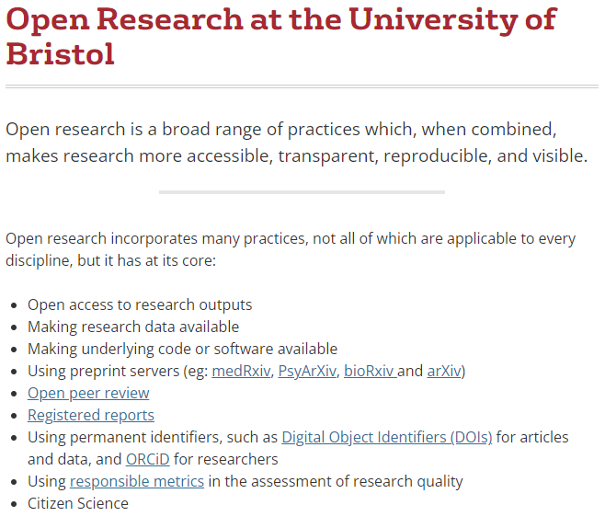
https://www.bristol.ac.uk/staff/researchers/open-research/

Slide 4
Library Research Support
Research Data Service
Data Management Plans
Data Storage advice
Help plan research work packages to support data release
Data.bris repository
Data Sharing
Open
Processes for restricted/controlled data release
Disclosure Risk Assessment
Consent for data sharing
Open Access Team
Gold Open Access APC funds e.g. UKRI and Wellcome
Scholarly works policy
‘For the purpose of open access, the author(s) has applied a Creative Commons Attribution (CC BY) licence to any Author Accepted Manuscript version arising from this submission.’
Open Access Advocacy role
Open Research Community Manager

Slide 5
Policies by Nick Youngson CC BY-SA 3.0 http://pix4free.org

Slide 6
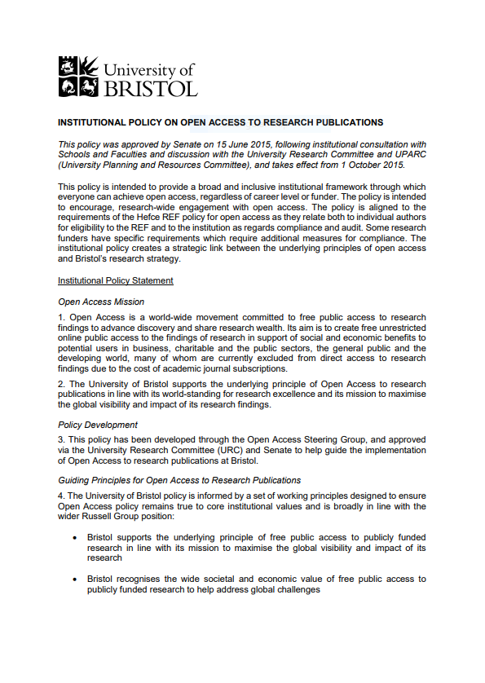
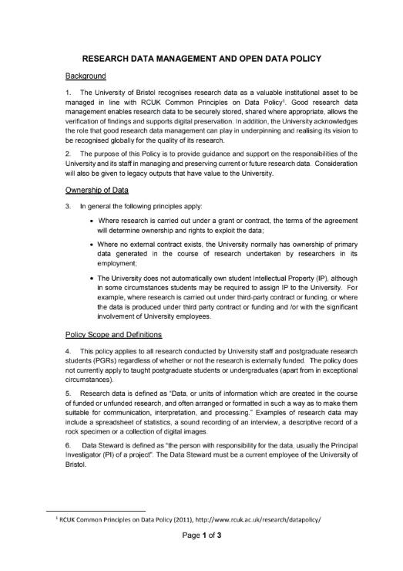
Old policies
Wordy and boring
(and nobody reads them)
External drivers, nothing about research culture
Long lead in from development to endorsement
Not agile – can’t easily update to reflect new open research practices or policies

Slide 7
New policies
2021 Research Support Team benchmark exercise
Looked for
Open Research statements
Policies
Who ‘owns’ these?
Library?
Research Office?
Research Committee?
University Senior Team?
Change of tone
Mission statement front and centre
Open and transparent research culture as central principle
Modular
Agile
Sub polices are practical ‘how to’ guides
Linked to University website project

Slide 8
Open Research Policy
FAIR data: storage and sharing
Open access: publications and preprints
Open and FAIR code
Preregistration
Public and Patient Involvement
Coproduction
Citizen Science

Slide 9
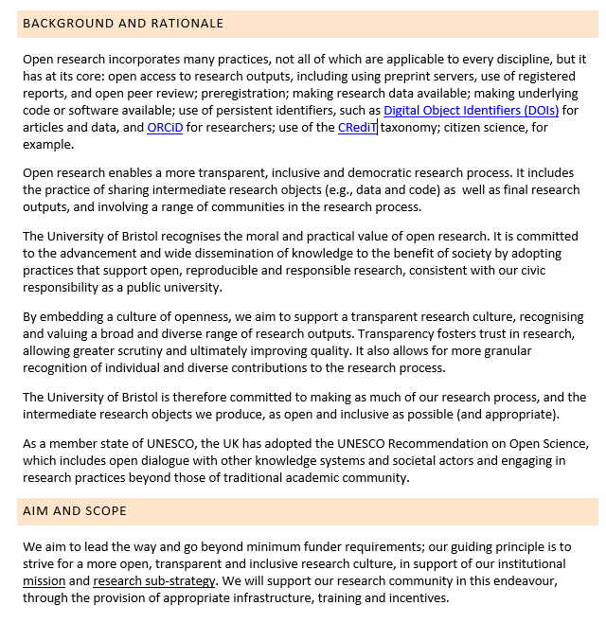
FAIR data: storage and sharing
Open and FAIR code
Open access: publications and preprints
Preregistration

Slide 11
UKRN Vision & Purpose
For the UK research system to be outstanding in conducting and promoting rigorous and transparent research.
The purpose of the UK Reproducibility Network (UKRN) is to enable researchers, institutions, and other stakeholders working in the UK to collaborate, so they are better able to conduct and promote rigorous, reproducible, and transparent research.
This includes: identifying the factors that affect research rigour and transparency; identifying, sharing, and integrating effective practice; supporting a culture of continual improvement; providing training and support; coordinating action; supporting inter- and trans-disciplinary research; influencing actors across the research system; and offering constructive challenge.

Slide 12
UKRN Local Networks and Institutional Members
75 Local Networks
36 Institutional Members
Notes:
This slide derives its data from: Cities file.xlsx If this powerpoint slide crashes, it may be best to avoid having that spreadsheet open at the same time.

Slide 13
Projects: diverse funding models
Traditional Funding
Collaborative Funding

Slide 19
Active global community
Notes:
This image is fed from: UKRN Contacts.xlsx RN tab. If this powerpoint crashes, avoid having that spreadsheet open at the same time as this powerpoint.

Slide 21
Contacts
Dr Kirsty Merrett
Research Support Librarian, Research Data Management & UKRN Open Research Programme j.k.merrett@bristol.ac.uk or lib-research-support@bristol.ac.uk
Professor Marcus Munafo
Associate Pro-Vice Chancellor for Research Culture at Bristol & Chair of UK Reproducibility Network’s Supervisory Board marcus.munafo@bristol.ac.uk
Dr Neil Jacobs
Head of UK Reproducibility Network’s Open Research Programme neil.jacobs@bristol.ac.uk

