Slide 1
OPEN SCIENCE@UMS
Prof. Dr. Rosalam Sarbatly Prof. Dr. Ag. Asri Ag. Ibrahim
Associate Prof. Dr. Fatimah Ahmedy Dr. Farashazillah Yahya

Slide 2
POLICIES AND GUIDELINES
CONTENT
INITIATIVES
INFRASTRUCTURE

Slide 3
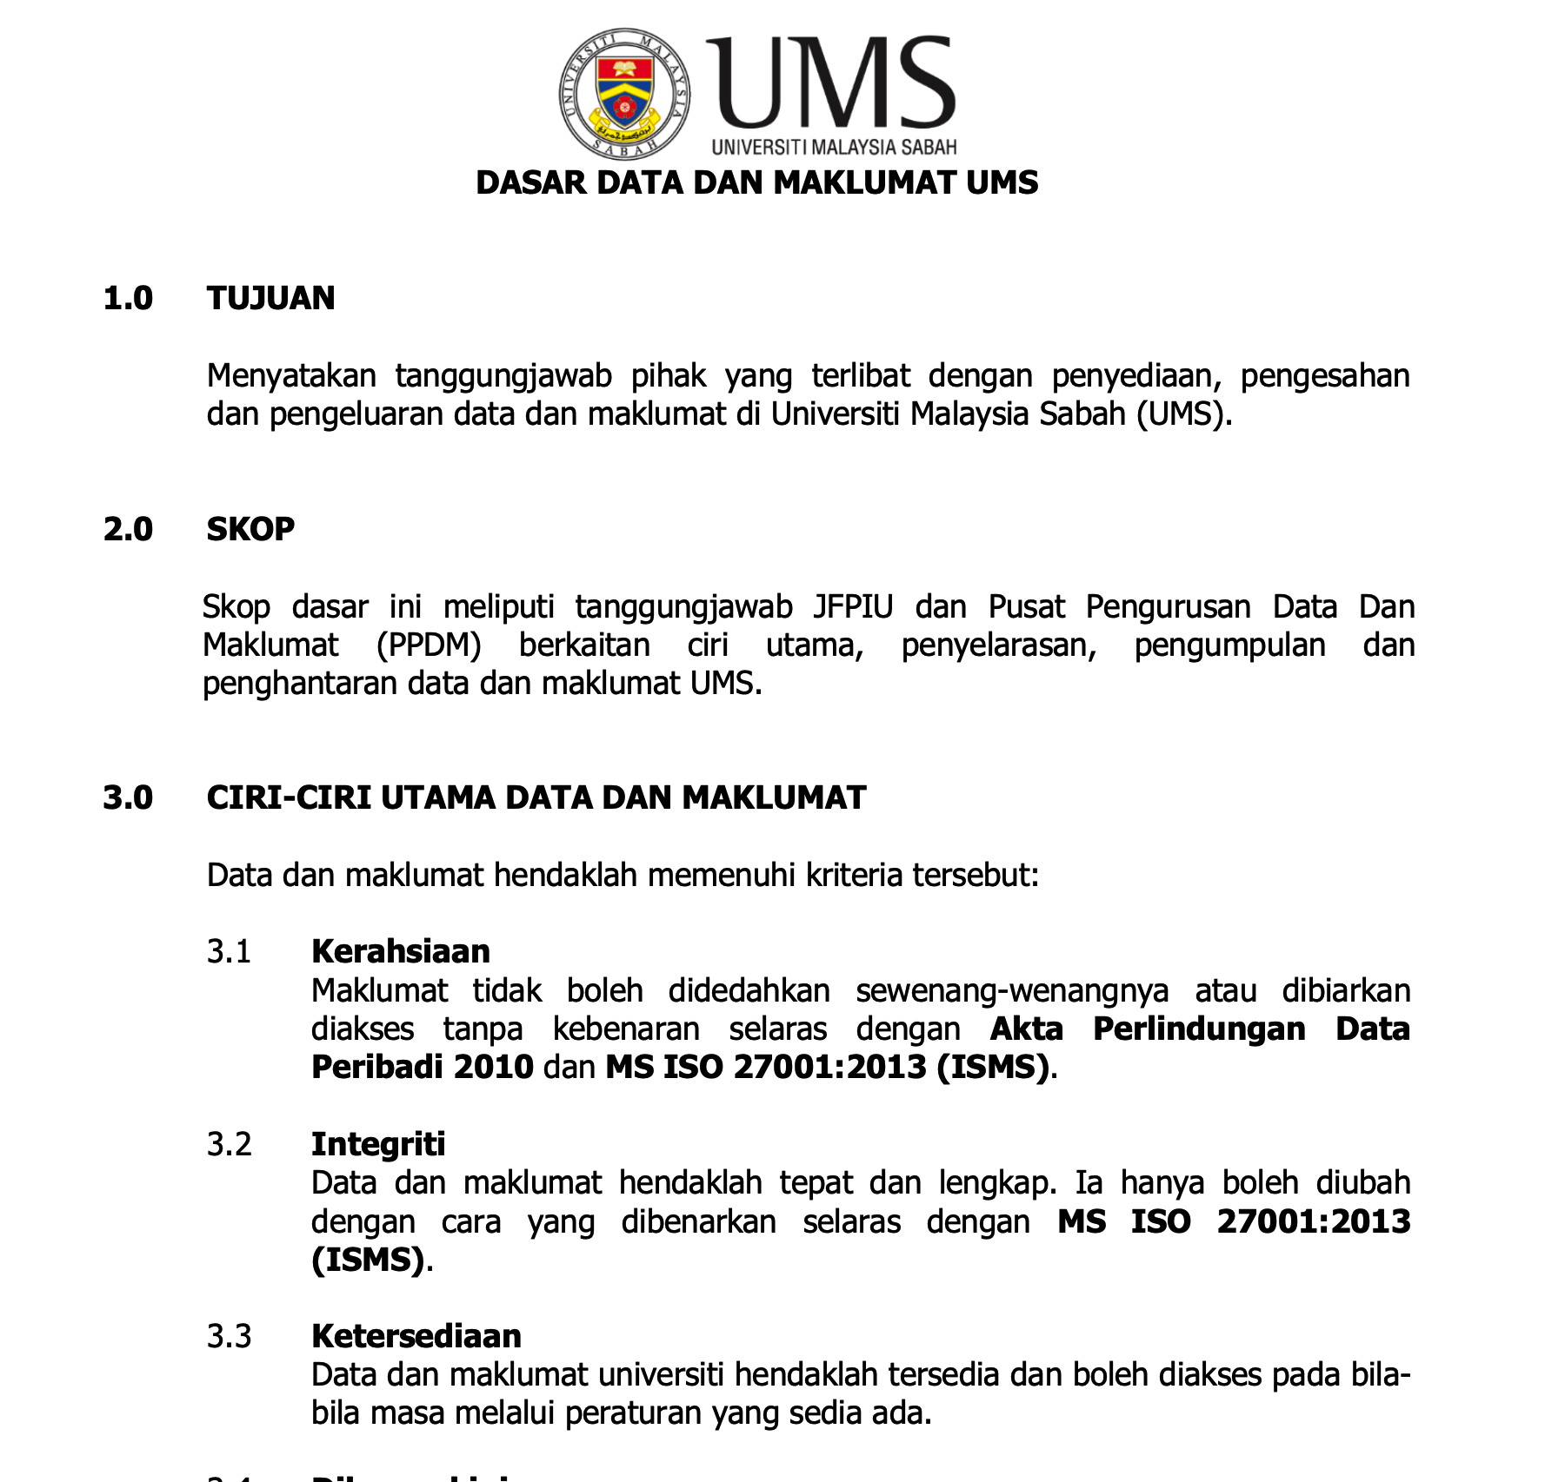
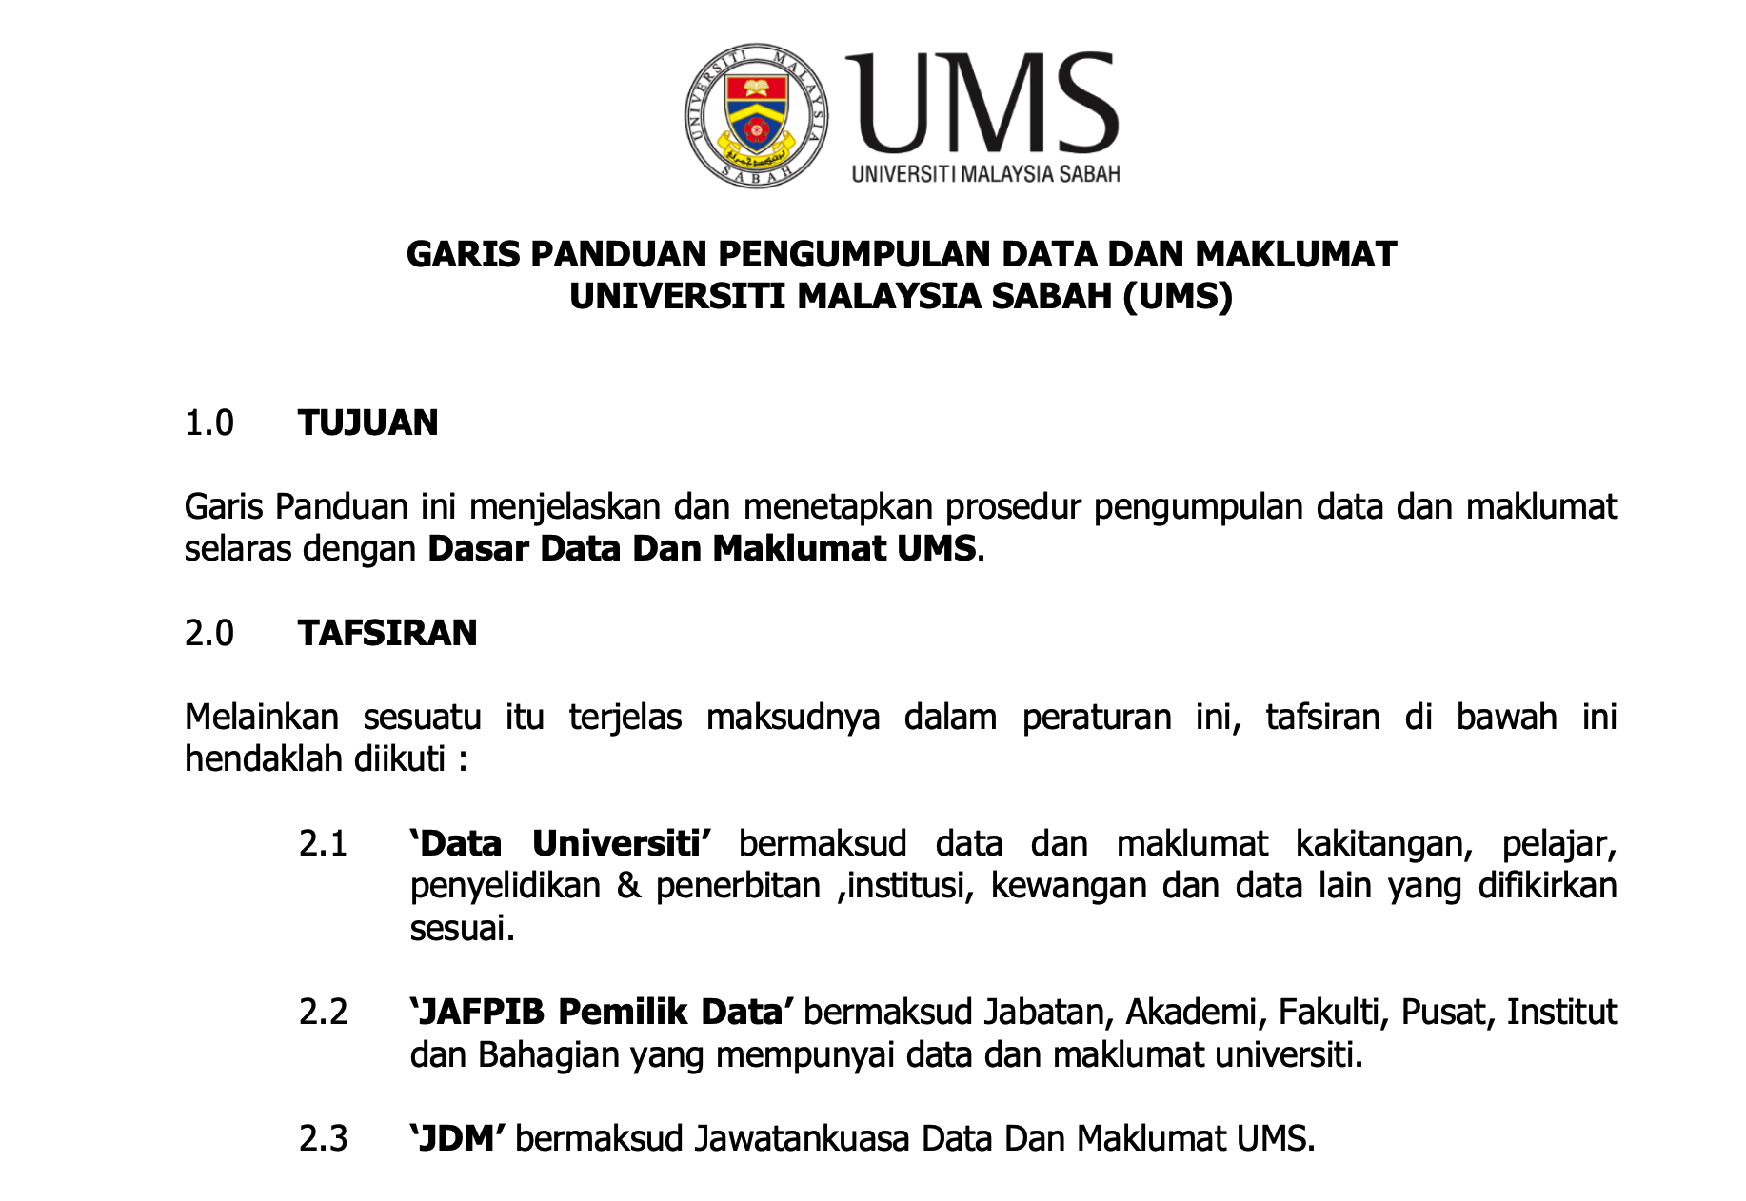
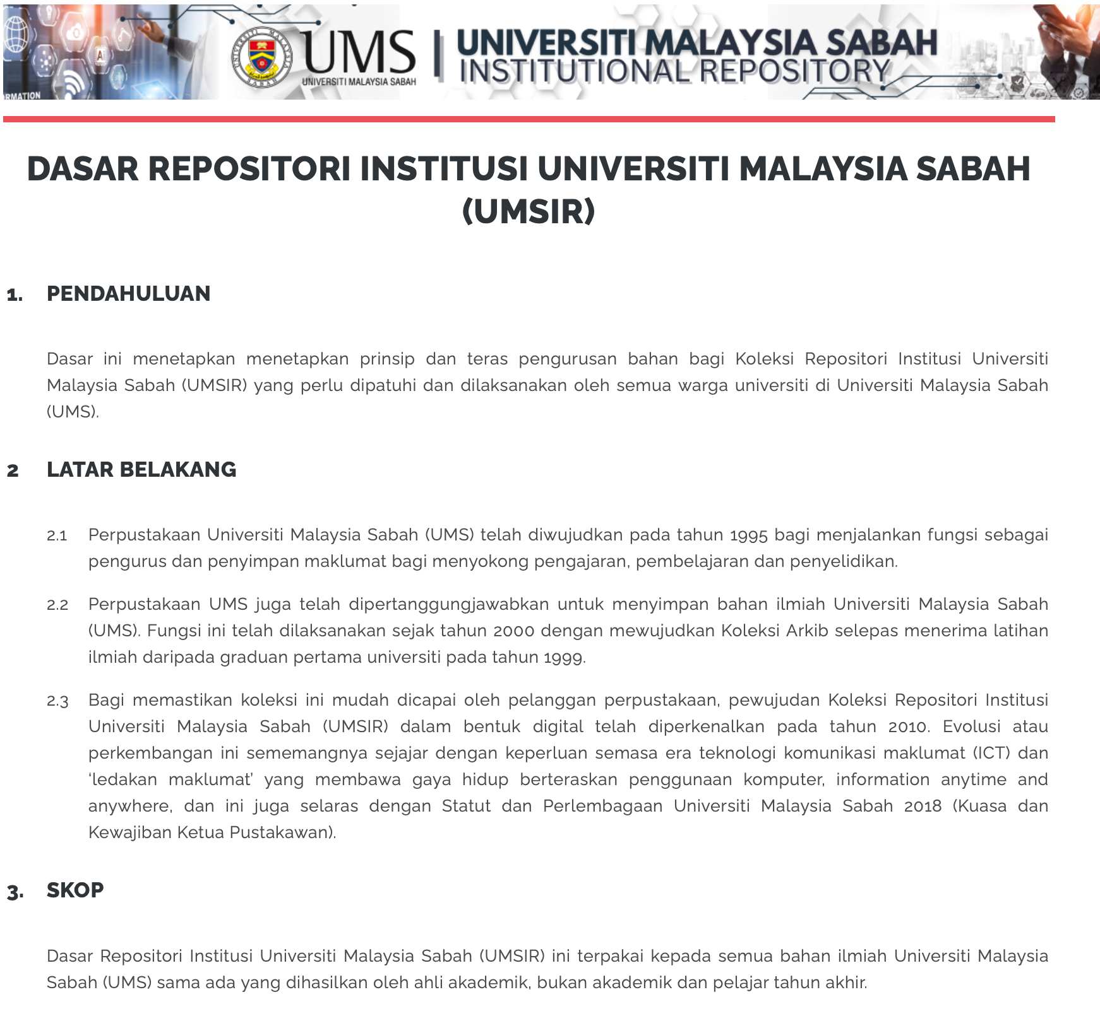
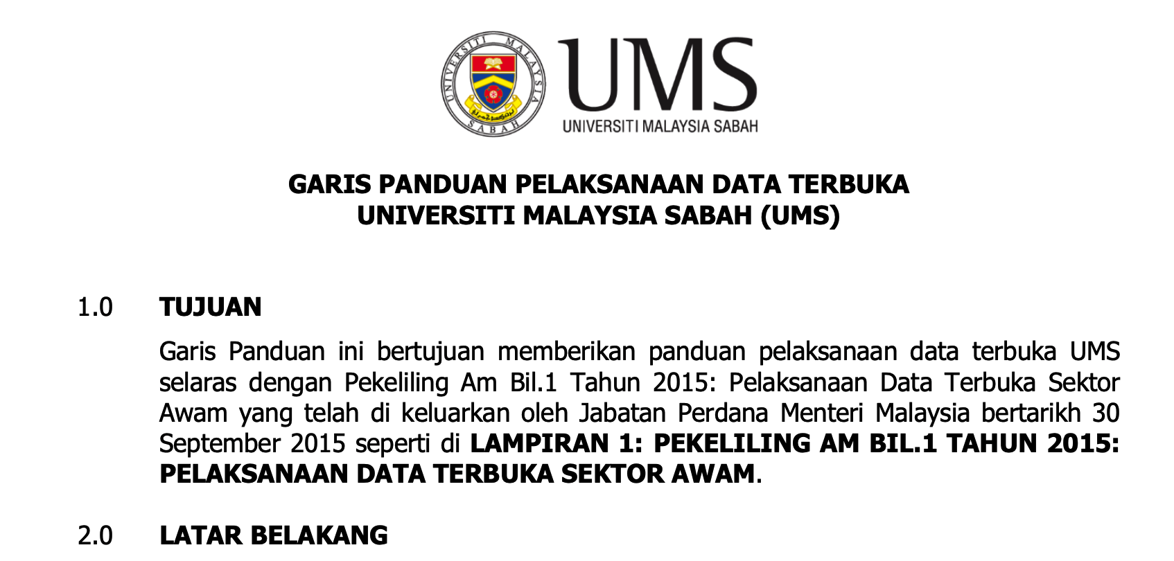
POLICIES AND GUIDELINES
UMS Data and Information Policy (2019) -
Dasar Data dan Maklumat UMS (2019)
UMS Data and Information Collection Guideline (2019) -
Garis Panduan Pengumpulan Data dan Maklumat UMS (2019, pindaan terkini tahun 2022)
UMS Data Application and Submission Guideline (2019) -
Garis Panduan Permohonan dan Penghantaran Data UMS (diluuskan tahun 2019, pindaan terkini tahun 2023)
UMS Open Data Guideline (2023) -
Garis Panduan Data Terbuka UMS
UMS Institutional Repository Policy
Dasar Repositori Institusi UMS (UMSIR)

Slide 4
INITIATIVES
iOER
ePrints (UMS Institutional Repository)
Open Access Publication
Open Text Book
Open Data

Slide 5
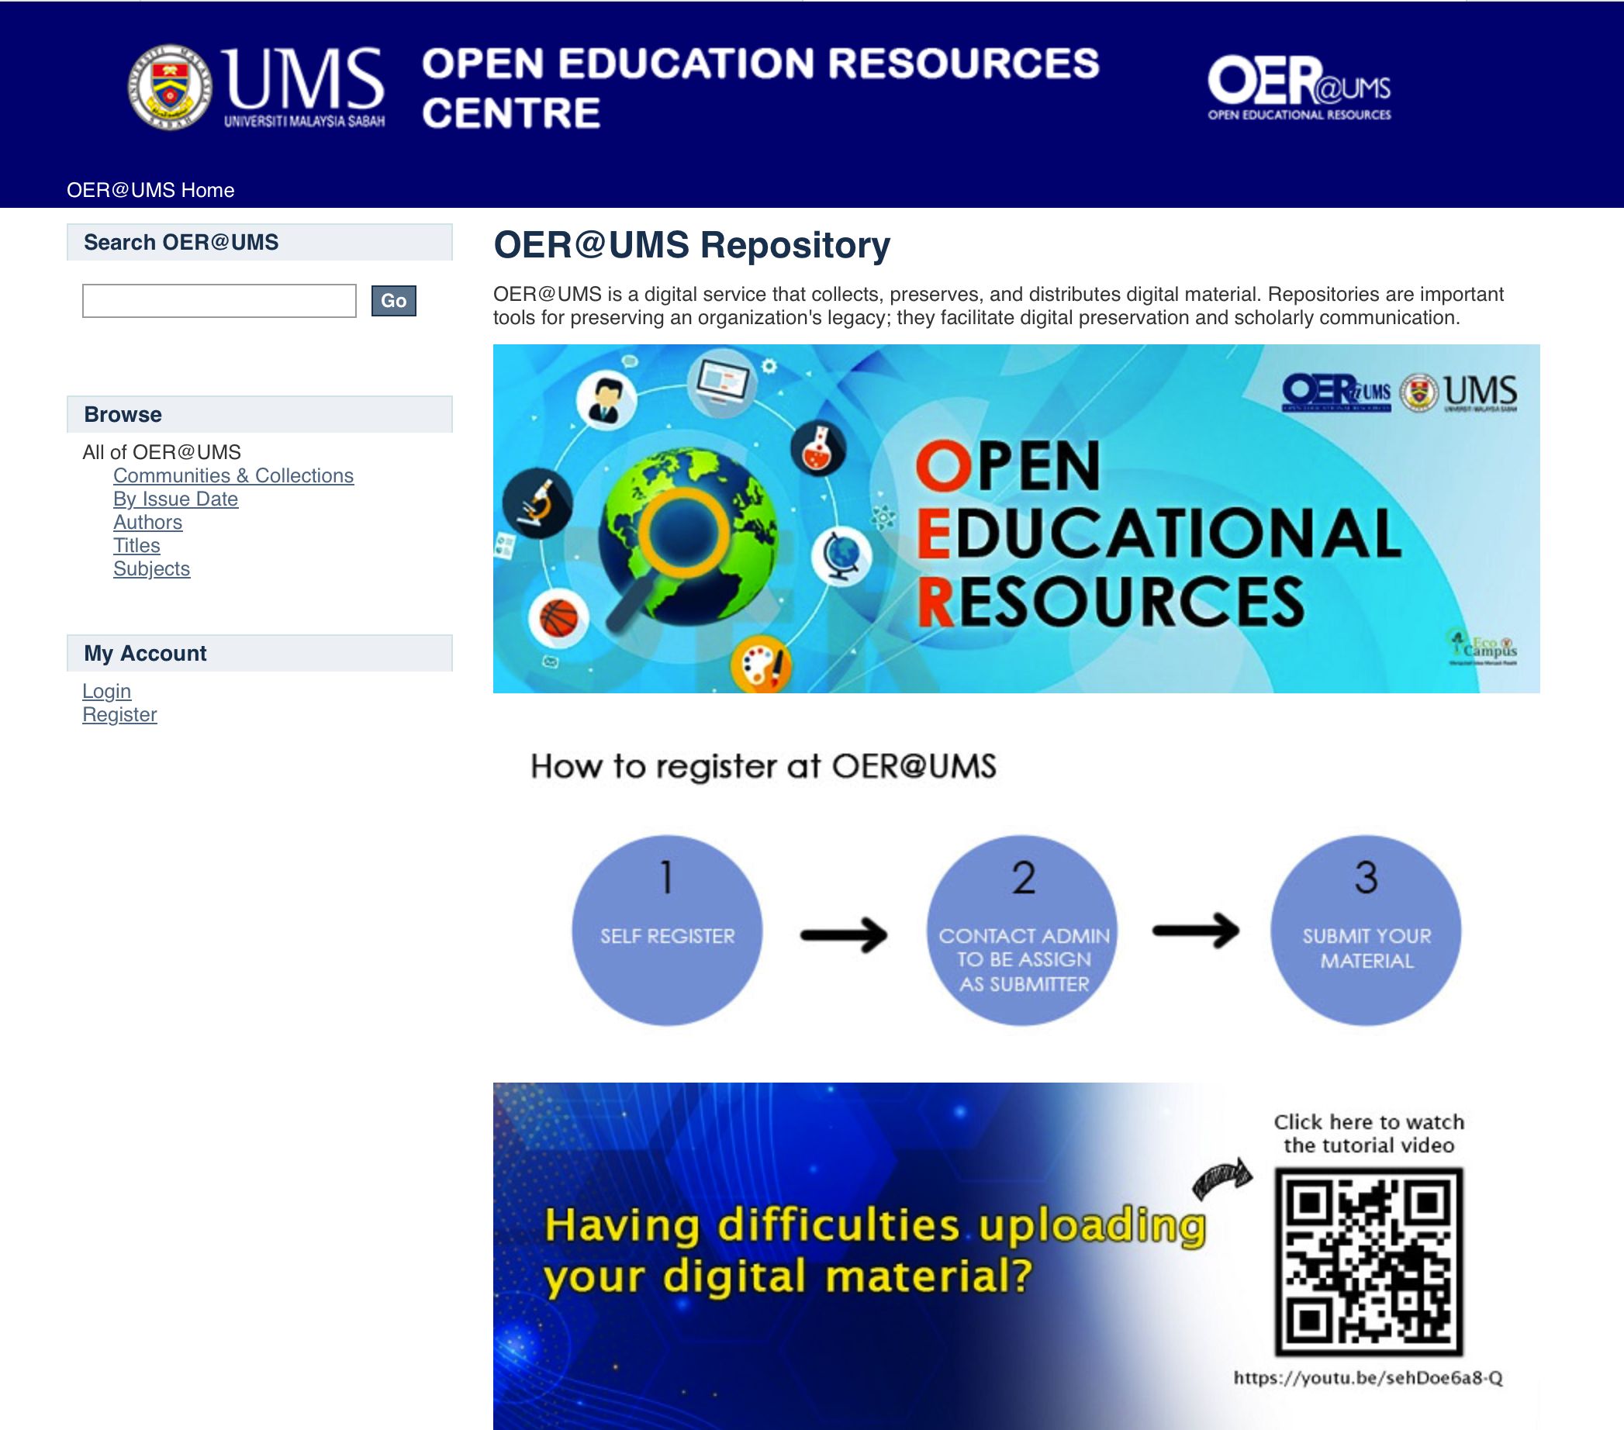
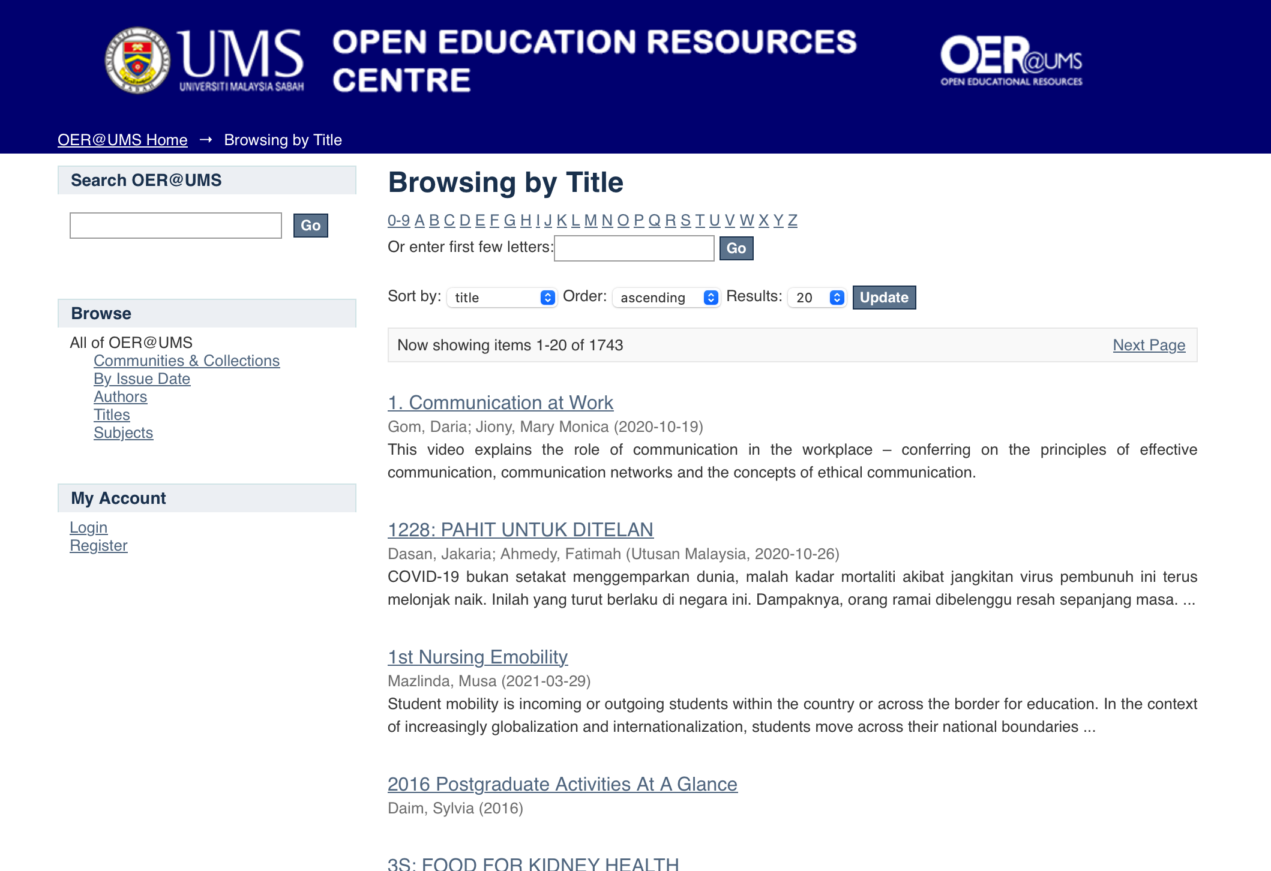
INITIATIVES
IOER

Slide 6
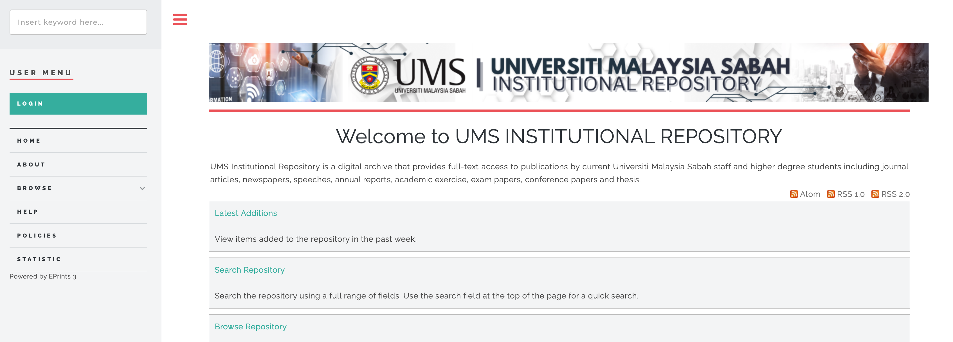
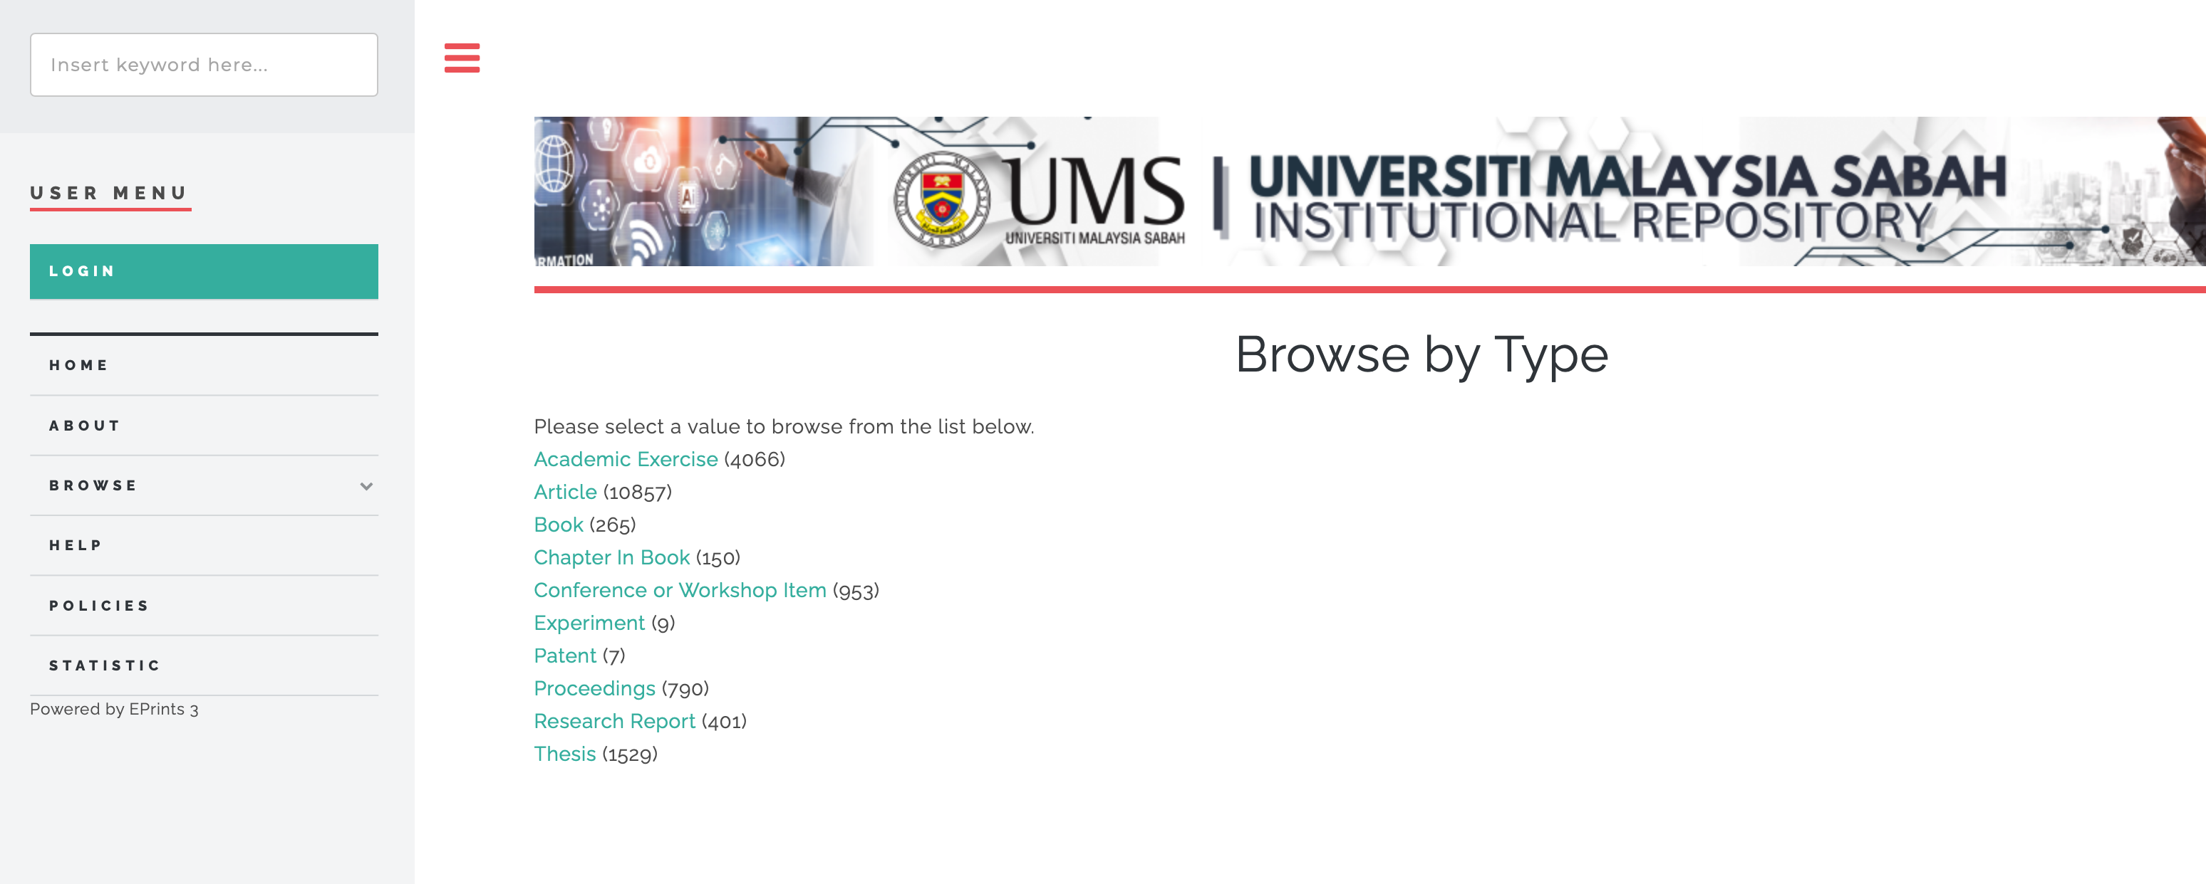
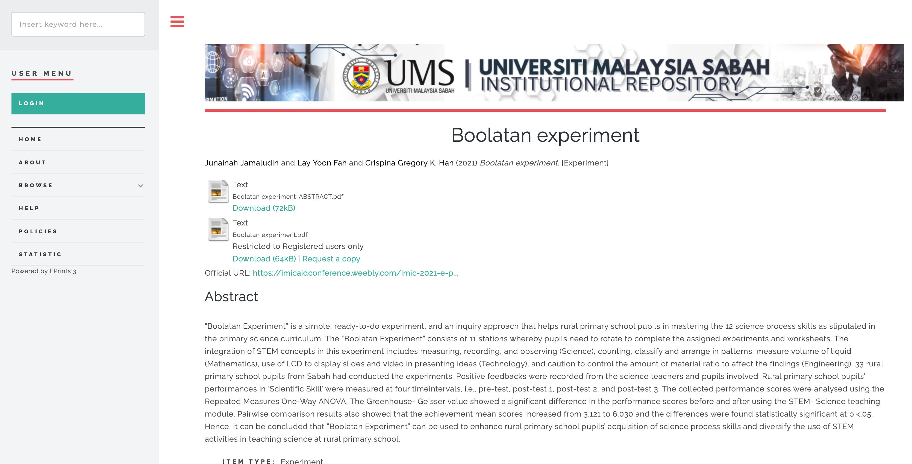
INITIATIVES
UMS Institutional Repository

Slide 7
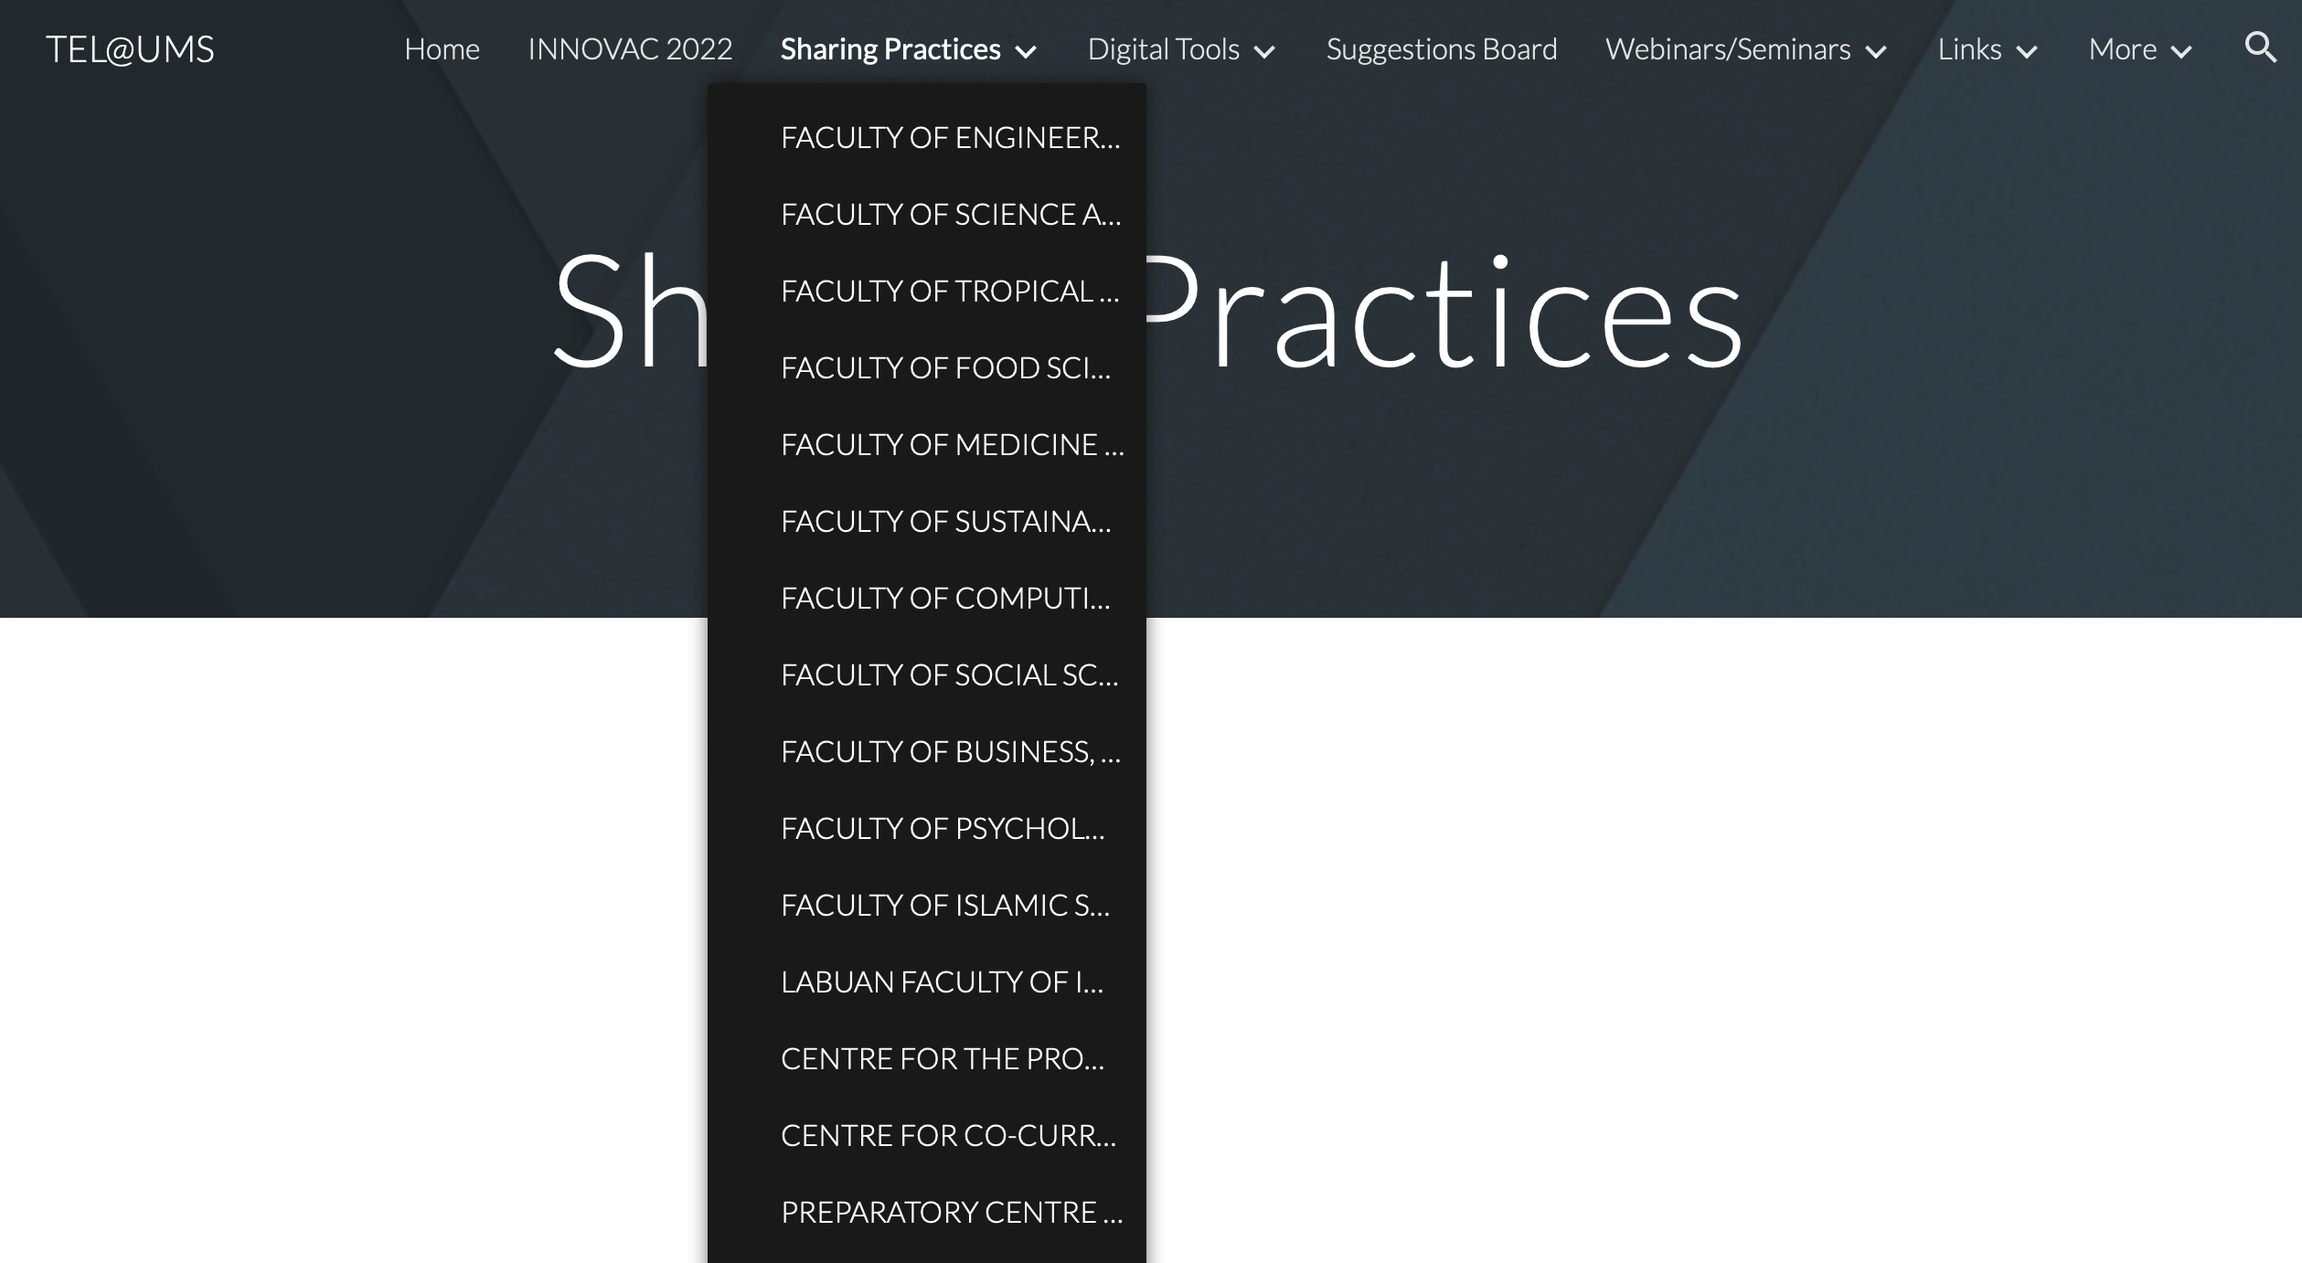
INITIATIVES
TEL@UMS sharing platform

Slide 8
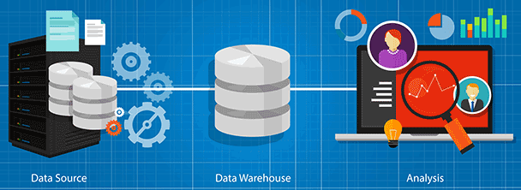
INFRASTRUCTURE
Strategies and activities related to the business, applications, technology, storage, organisation, and description of data and related research materials.
Enterprise Architecture
Data Architecture
Data Warehouse
Centralised Data Repository
Data Integration and Standardisation
Scalability and Performance
Data Governance and Security
Big Data Analytics
Dashboards and Advanced Analytics
Data Lake

Slide 9
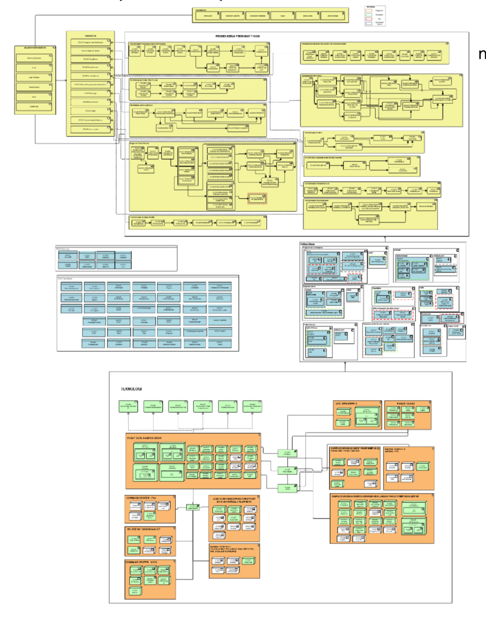
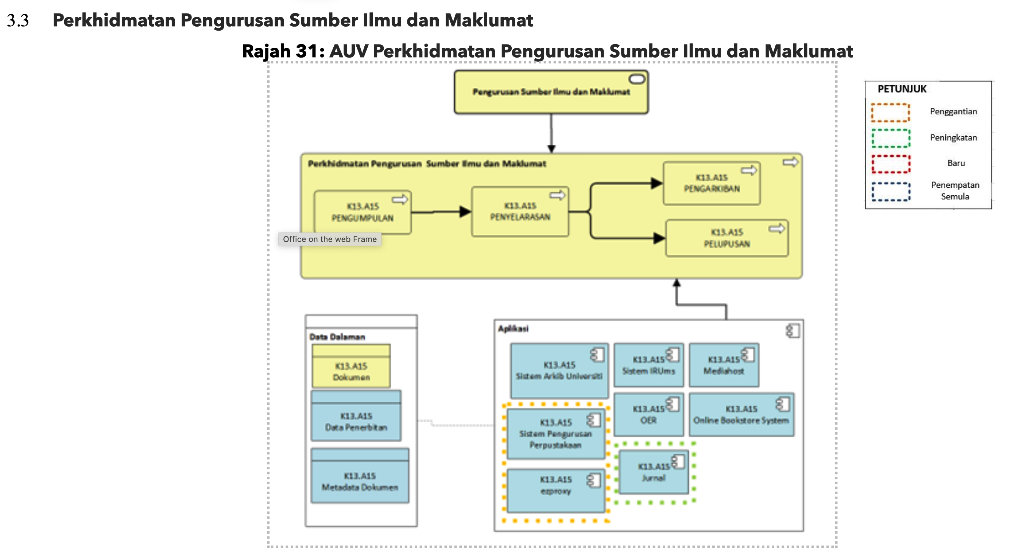
INFRASTRUCTURE
EA UMS
Enterprise Architecture

Slide 10
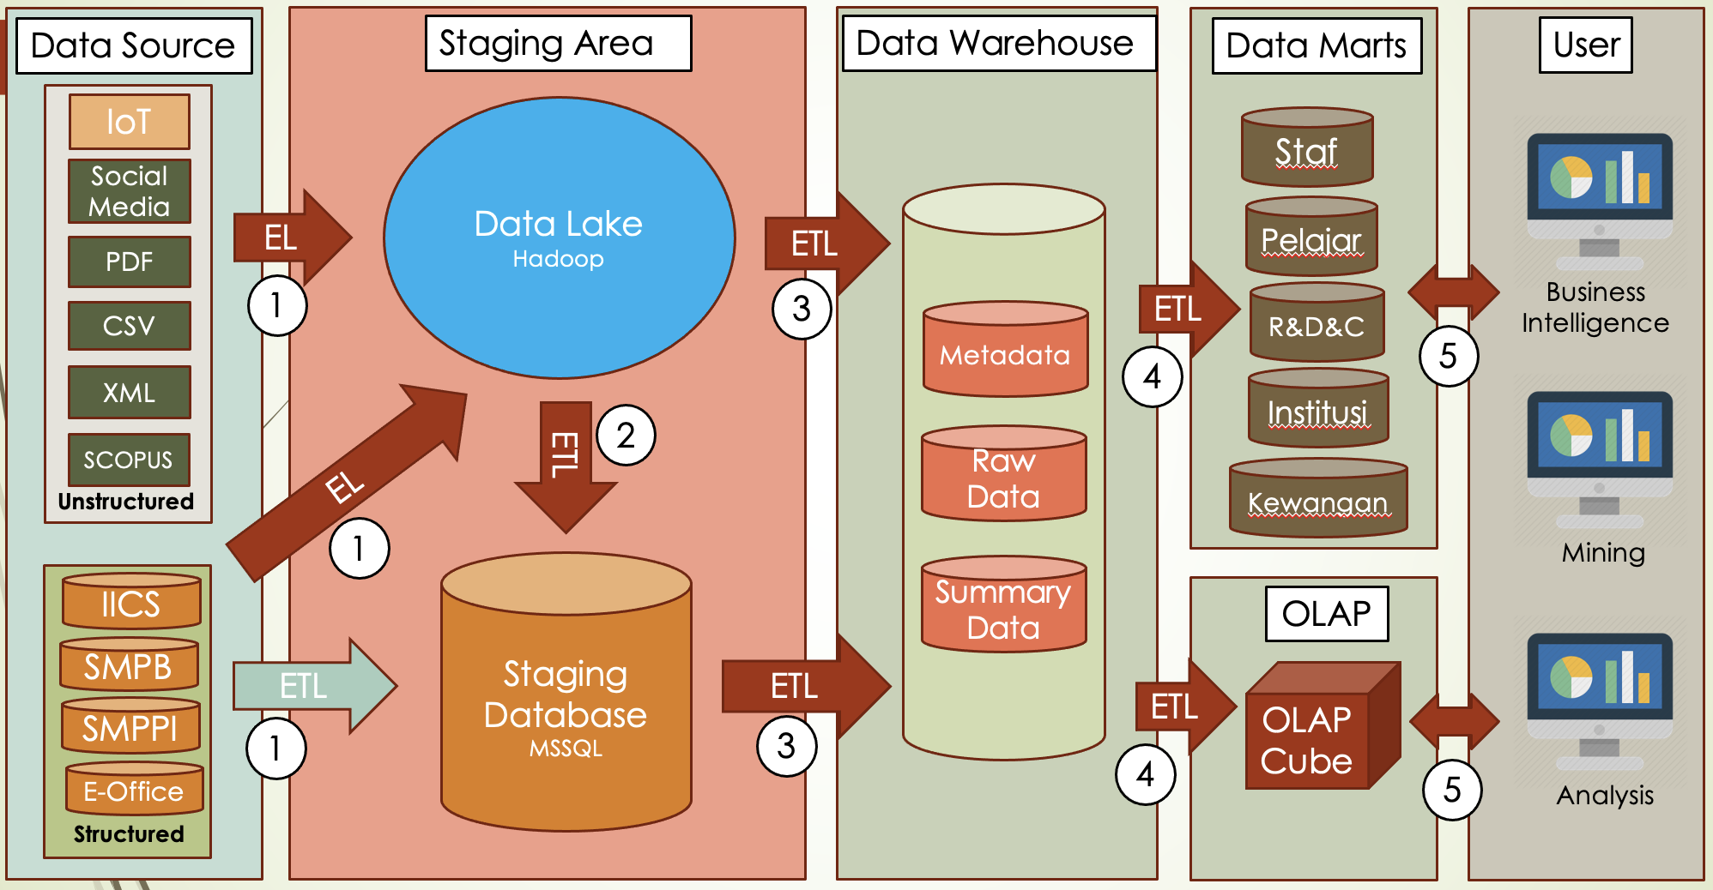
UMS DATA ARCHITECTURE

Slide 11
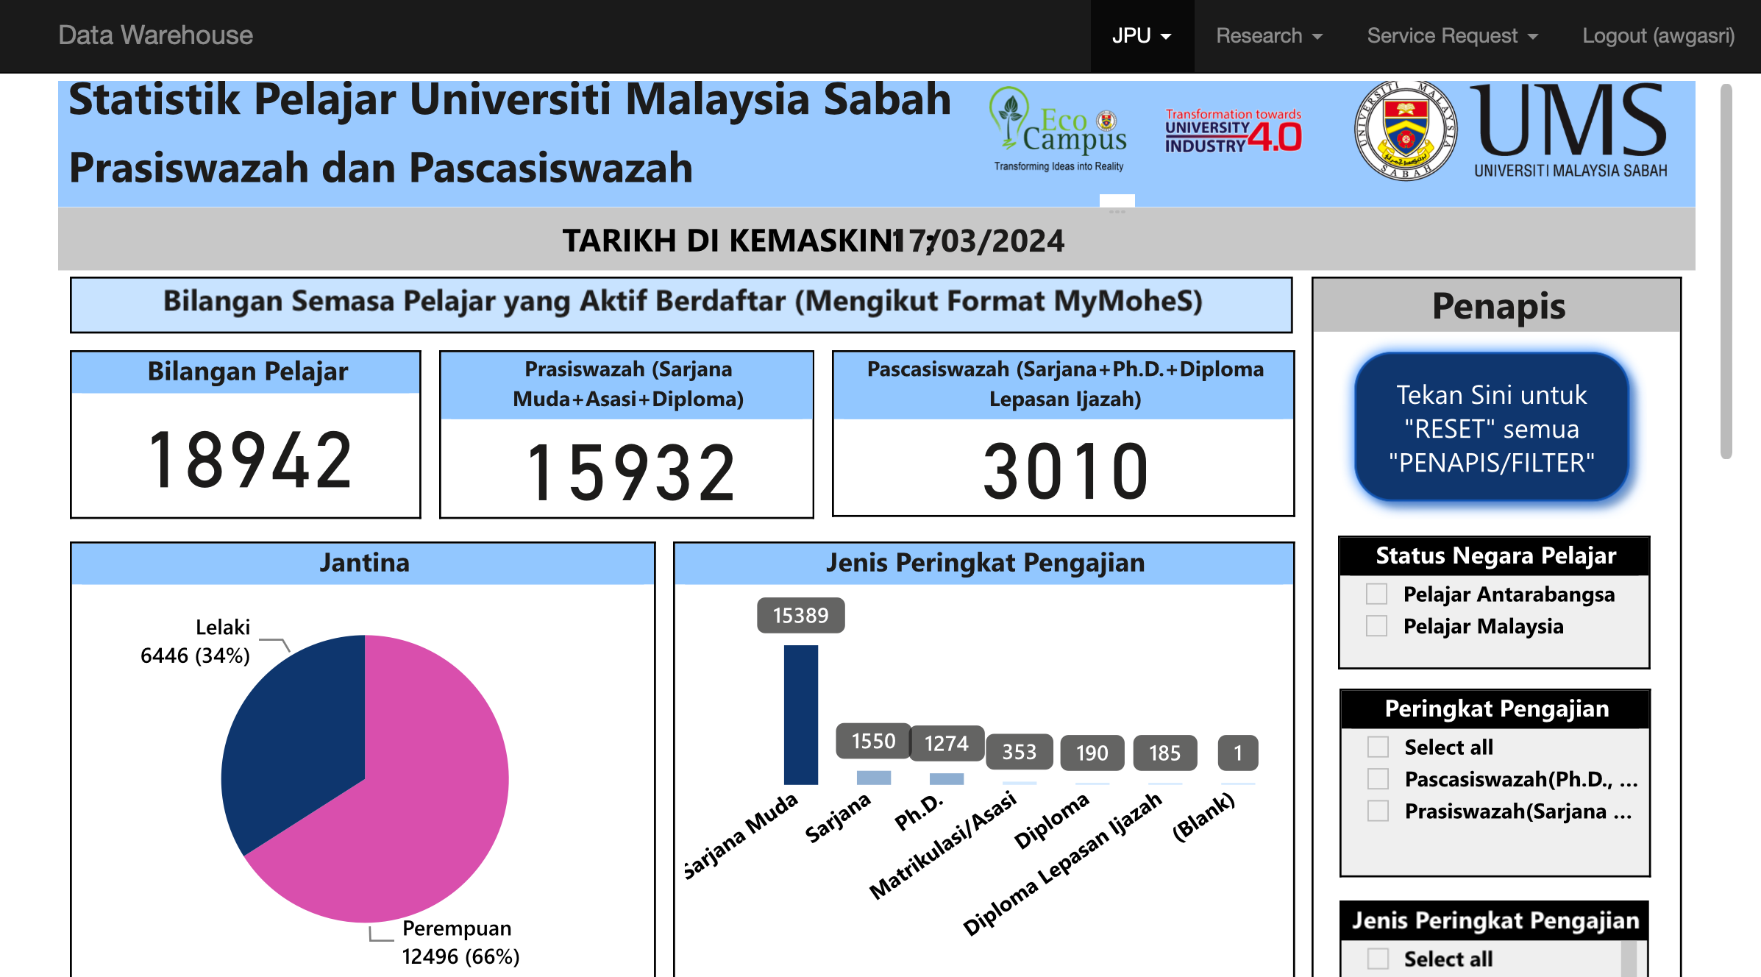
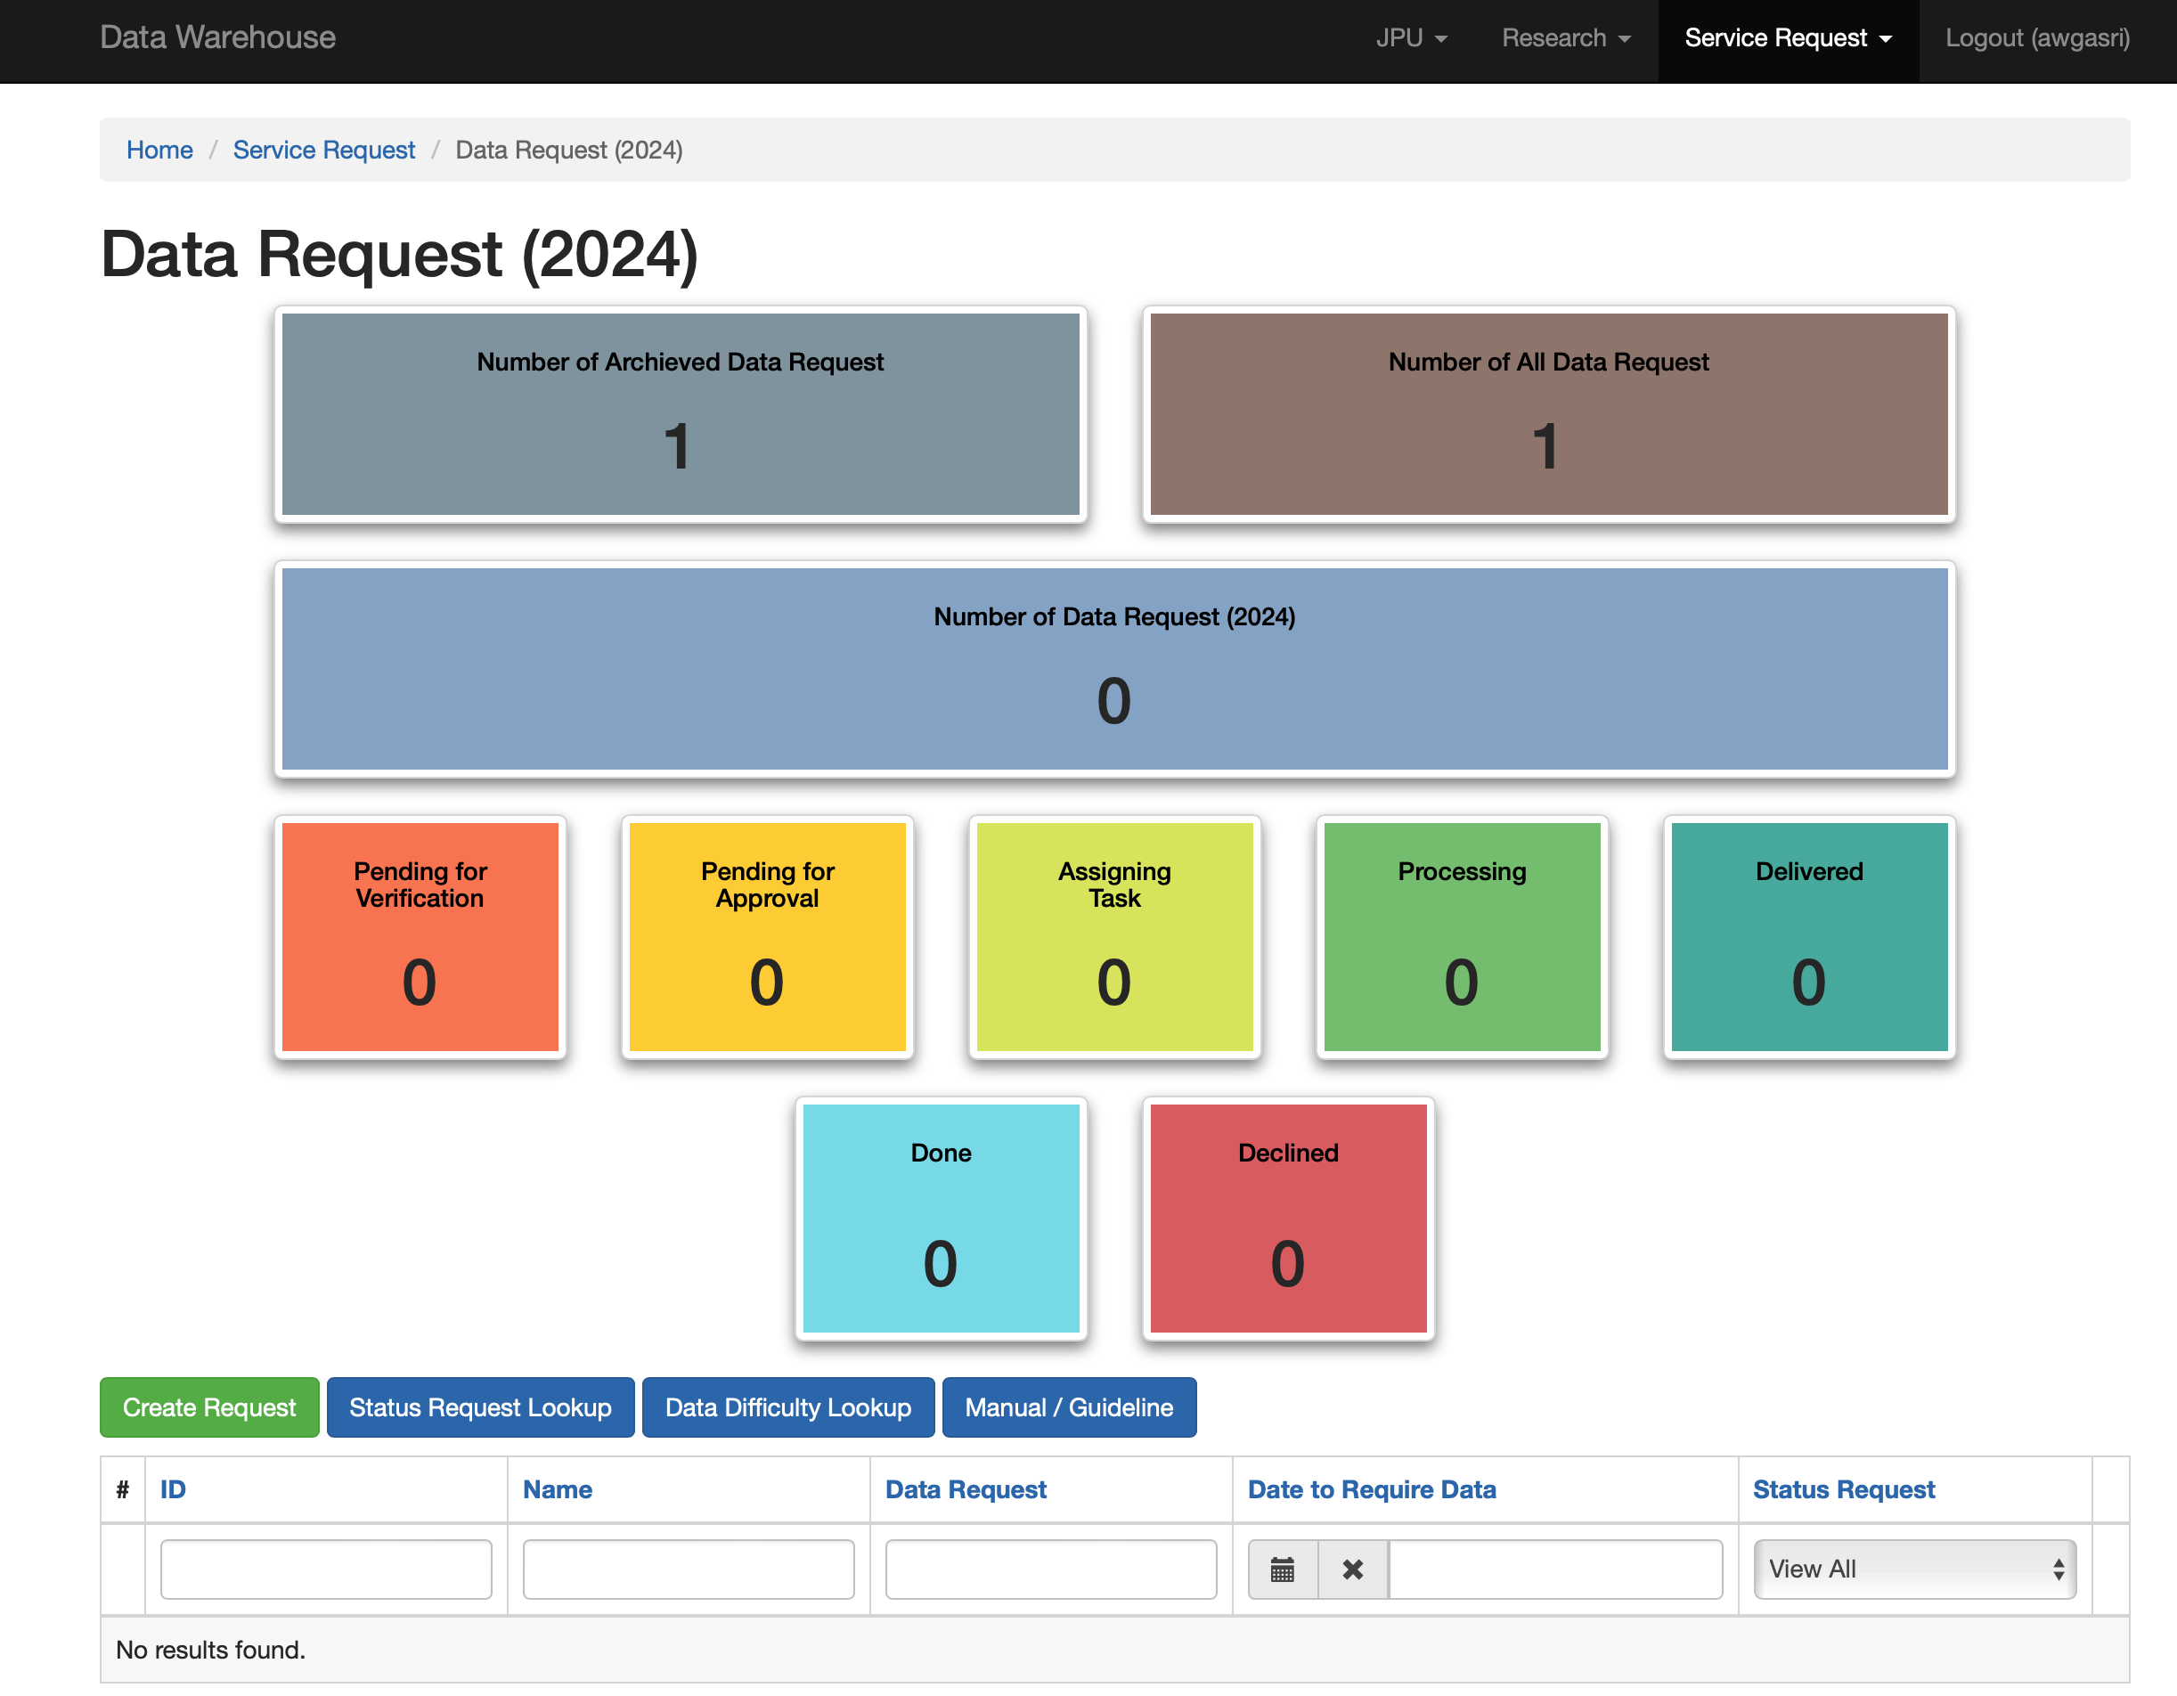
INFRASTRUCTURE
DWH@UMS

Slide 12
THANK YOU

