Slide 1
Pioneering UM Open Science: Experiences, Insights & Opportunities
Abrizah Abdullah
Dean, Institute for Advanced Studies, Universiti Malaya
Professor, Dept of Library & Information Science,
Faculty of Arts & Social Sciences, Universiti Malaya
Open Science Forum -1 (OSF-1)
Thursday, 21st March 2024
NMIMS University, Mumbai, India

Slide 4
Open Science Implementation
Open Science
People
UMOS
Prepare the researchers and train the data stewards to support the initiative
An UM initaitive to democratise knowledge
Policy & Processes
Platform
Define what (policy) and how (guideline) of the Open Science context in UM
The data deposit and sharing platform, and the supporting services.

Slide 5
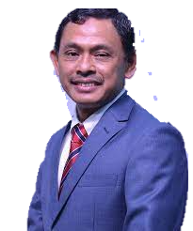
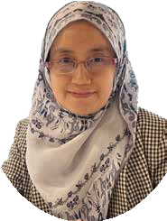
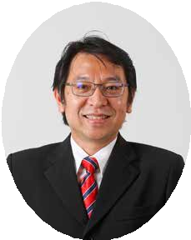
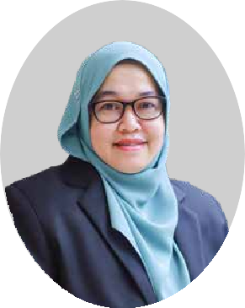
Governance Structure
DEPUTY VICE CHANCELLOR RESEARCH & INNOVATION
Professor Ir. Dr. Kaharudin Bin Dimyati
UM OPEN SCIENCE STEERING COMMITTEE
Chaired by DVC R&I
Members:
Prof Ir Dr Ramesh Singh A/L Kuldip Singh
Prof Ir Dr Shaliza Ibrahim
Prof Dr Abrizah Abdullah
Prof Dr Sharifuddin Md Zain
Prof Dr Saiful Anuar Karsani
Prof ChM Dr Noorsaadah Abd Rahman
Prof Ts Dr Ainuddin Wahid Abdul Wahab
Prof Ts Dr Nor Badrul Anuar Juma’at
AP Dr Liew Chee Sun
Dr Nurzatil Sharleeza Mat Jalaluddin (UMOS Coordinator)
AP Dr Yanti Idaya Aspura Mohd Khalid
UM OPEN SCIENCE
Coordinator: Dr Nurzatil Sharleeza Mat Jalaluddin
Secretariat: Puan Azlina Sardi
UMOS Data Custodian
Coordinator: AP Dr Liew Chee Sun
UMOS Data Stewards (Research)
Coordinator: Puan Sabariah Basir
UMOS Data Stewards
(Policy & Guidelines)
Coordinator: To be confirmed

Slide 6
POLICY: UM Research Data Management
1. INTRODUCTION AND OBJECTIVES
.. This policy aims to ensure that research data generated in the conduct of research projects at UM are managed in a systematic and comprehensive manner to ensure integrity, accountability, long term availability, appropriate sharing and compliance with the requirements of funding agencies...
2. OTHER RELEVANT POLICIES AND GUIDELINES
This policy will operate in conjunction with other related UM policies and guidelines, the Malaysian Laws, and government policies and guidelines.
3. POLICY IMPLEMENTATION
The Research Management Office is responsible for the promulgation and implementation of the policy.
4. POLICY APPLICATION
... all UM staff, researchers, students and any other persons involved in the design, conduct, administration, or reporting of research performed at or under the auspices of UM including consultants, and visiting researchers....
5. REQUIREMENTS FOR RESEARCH DATA MANAGEMENT - Ownership, Data Management Plan, Deposit, Data Sharing, Retention, Disposal / Archive, Cost of managing research data
6. ROLES AND RESPONSIBILITIES - UM management, IT centre, Research Management Office, Academy, Faculty, Centres, Principal Investigators and Researchers, Librarians
Approved by LPU:
10 September 2020
Implementation:
Jan 2021
https://openscience.um.edu.my/um-research-policy

Slide 7
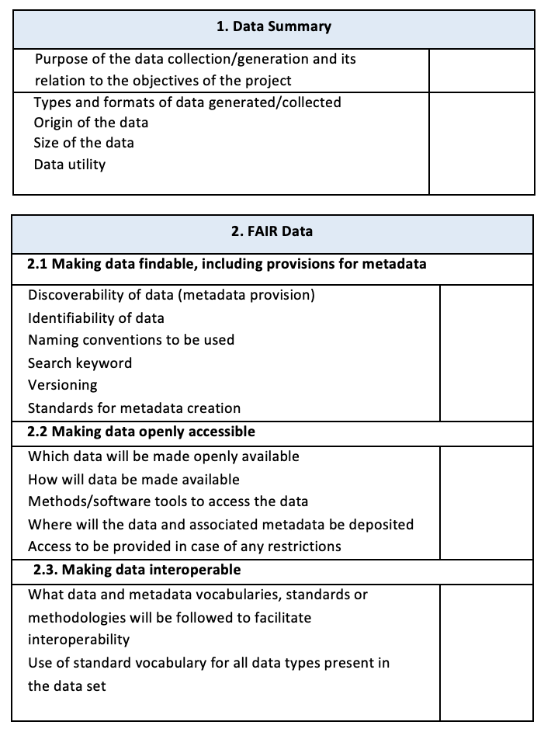
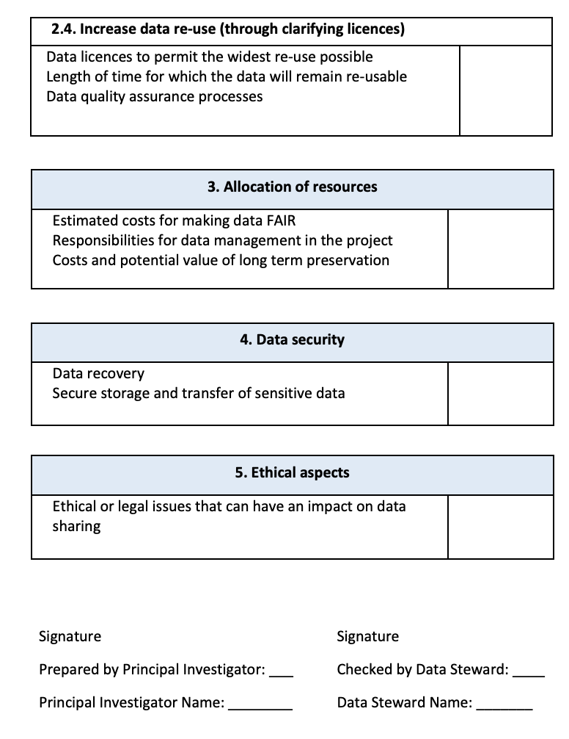
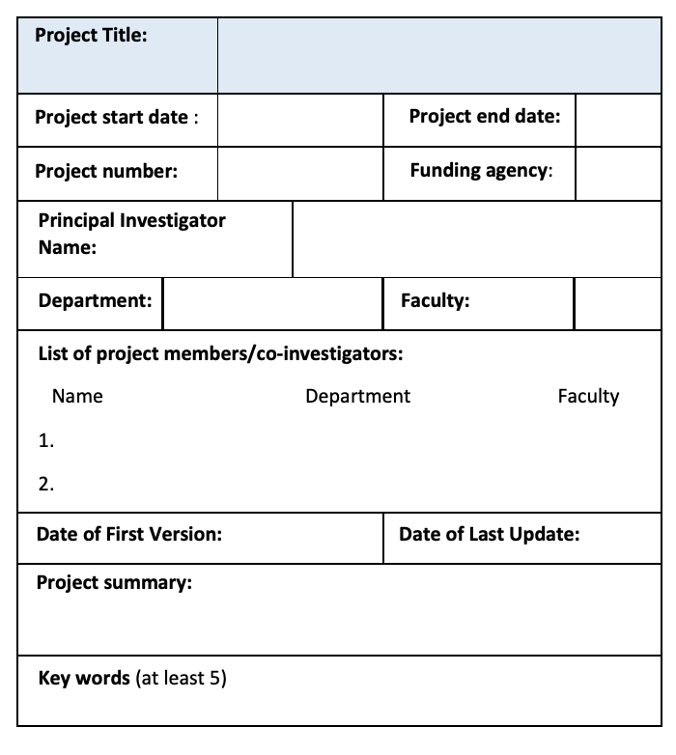
UM Research Data Management Plan (DMP)
A DMP describes how data in a research project will be collected, processed and made available. DMP will help researchers to consider every aspect of research data management from project start to data publication.

Slide 8
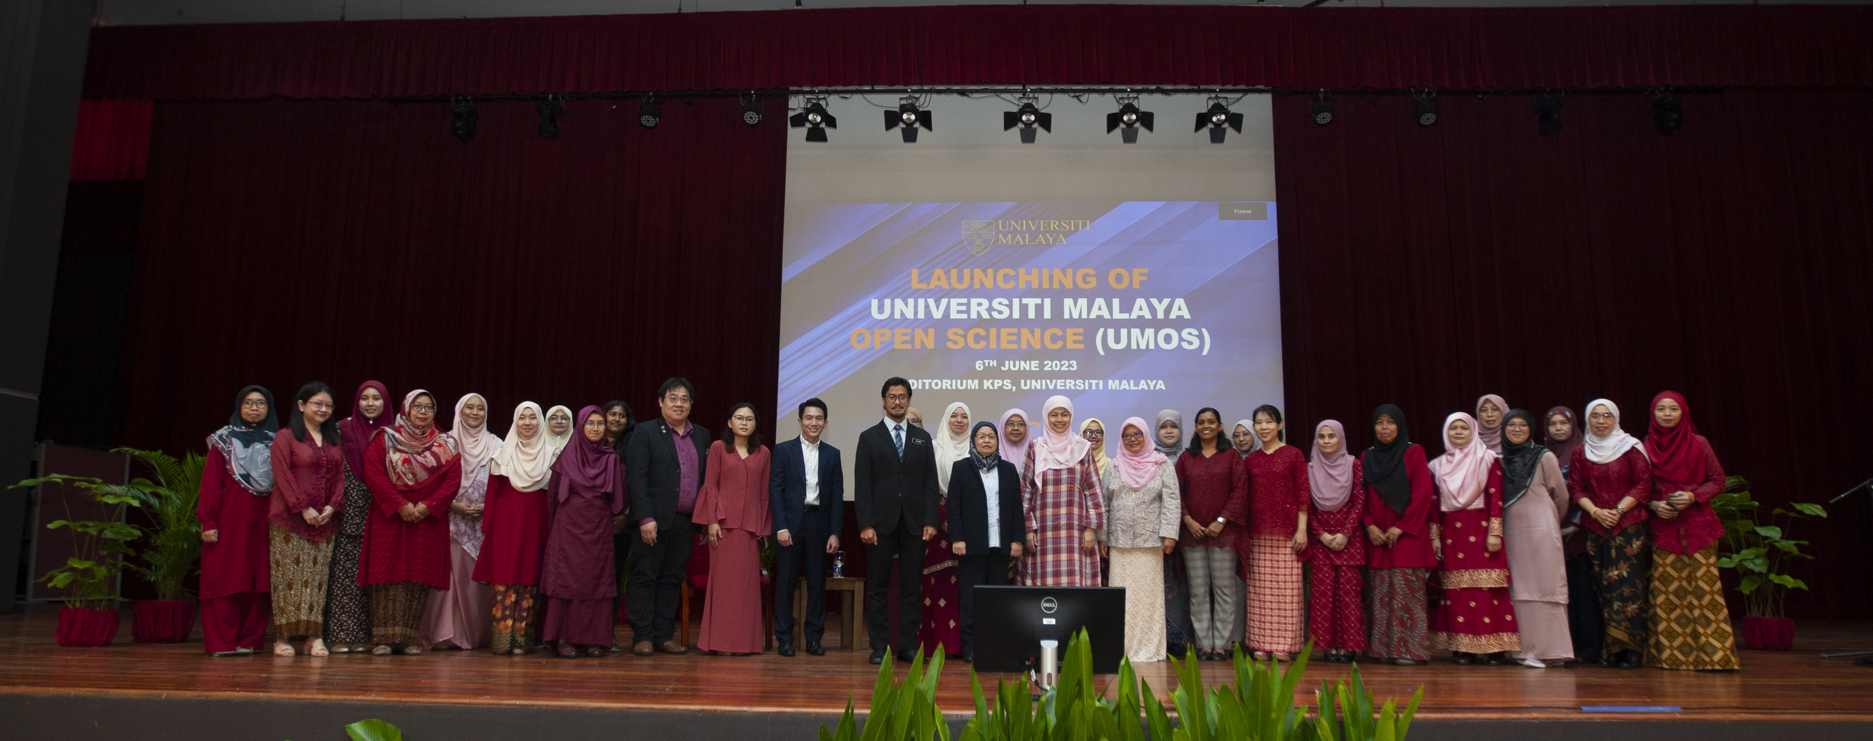
PEOPLE: UMOS Data Stewards
UMOS is supported by 32 data steward
technical support
advisory service
Responsible to partner with researchers from:
16 academic faculties / institutes,
6 HiCoEs and UMCoEs,
More than 30 research centres in UM

Slide 9
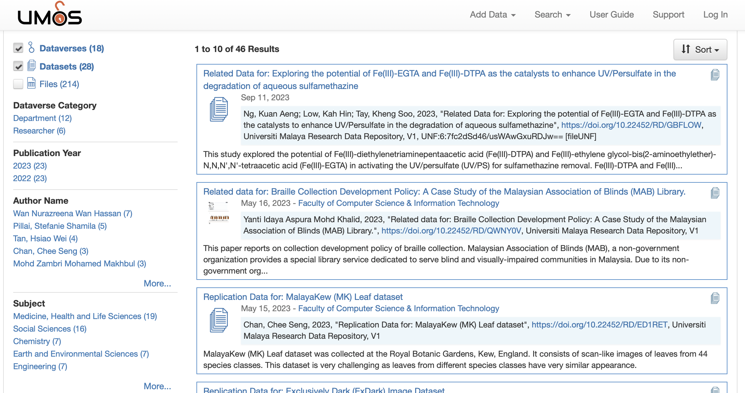
PLATFORM:
UM Research Data Repository https://researchdata.um.edu.my
Data repository for UM and is linked to the national MOSP portal (https://mosp.gov.my)

Slide 10
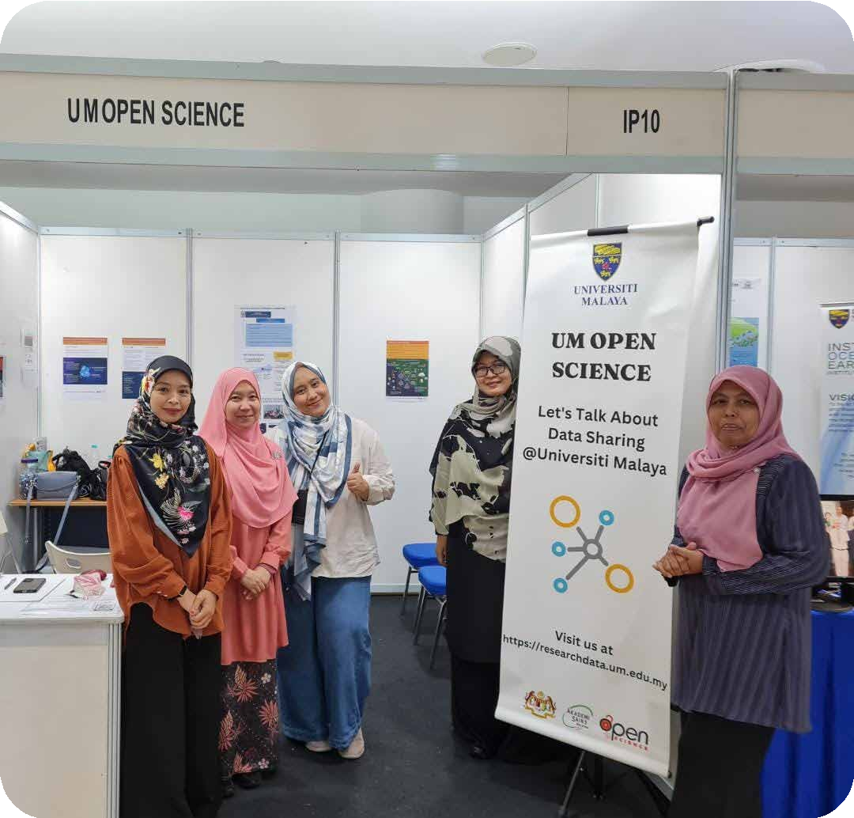
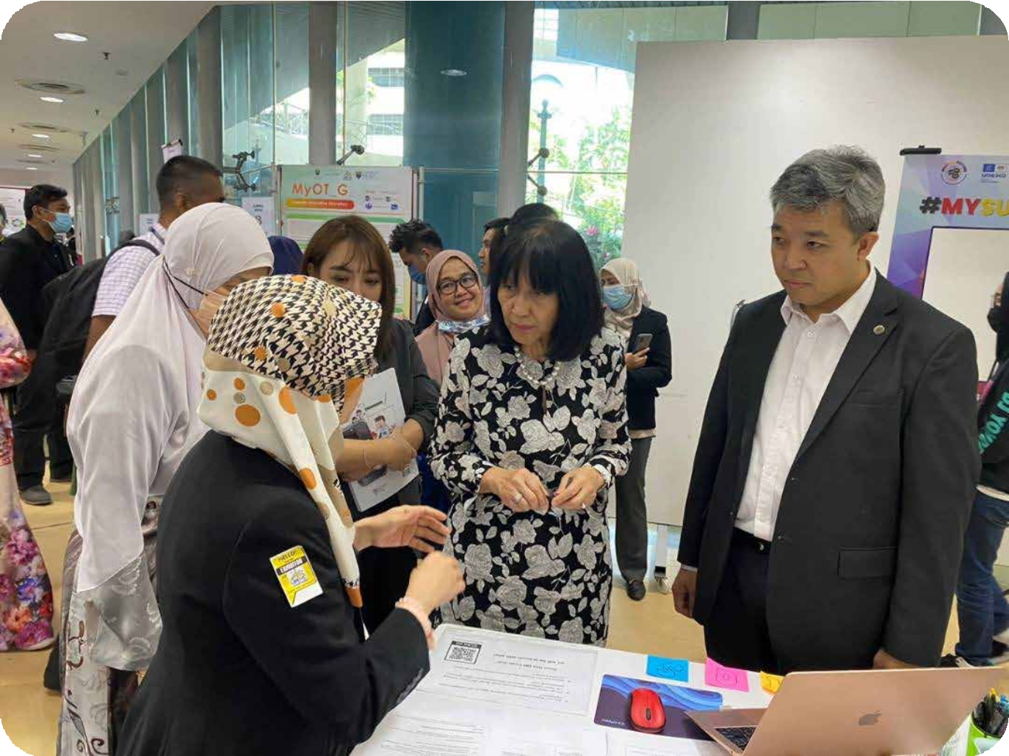
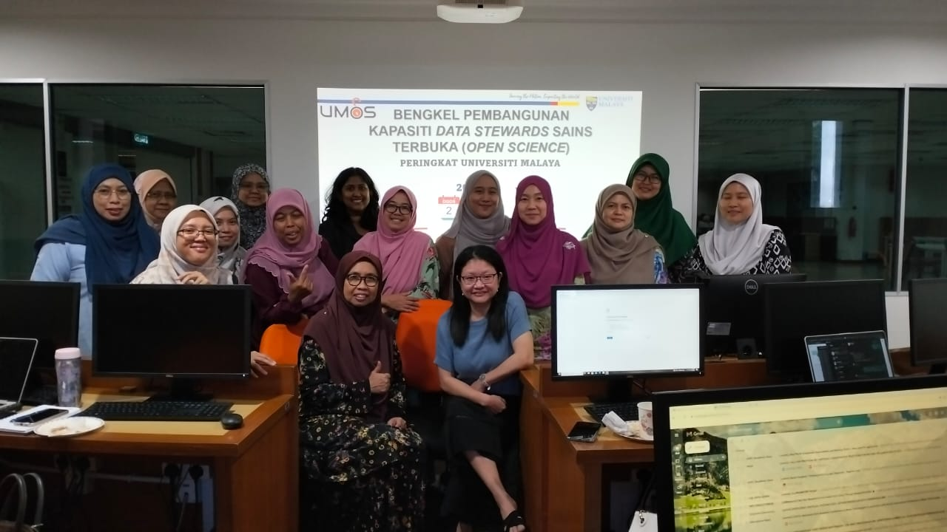
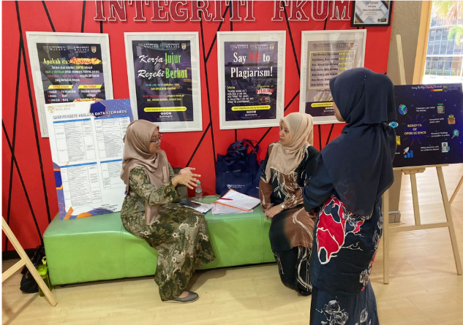
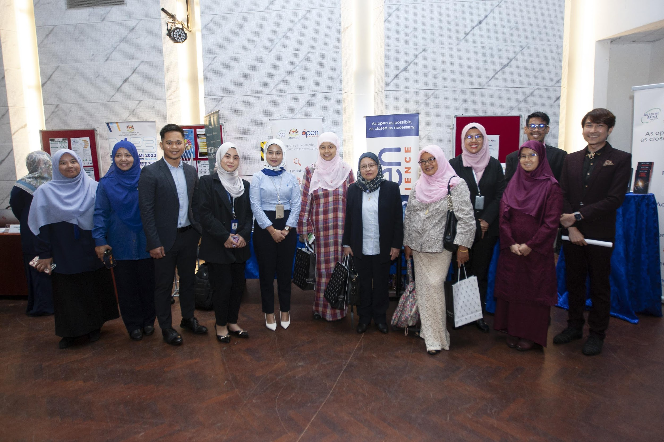
Outreach / Engagement / Collaboration
Launch of UMOS
RDM Workshops
Open Science Booths / Exhibitions / Roadshows to Faculties

Slide 11
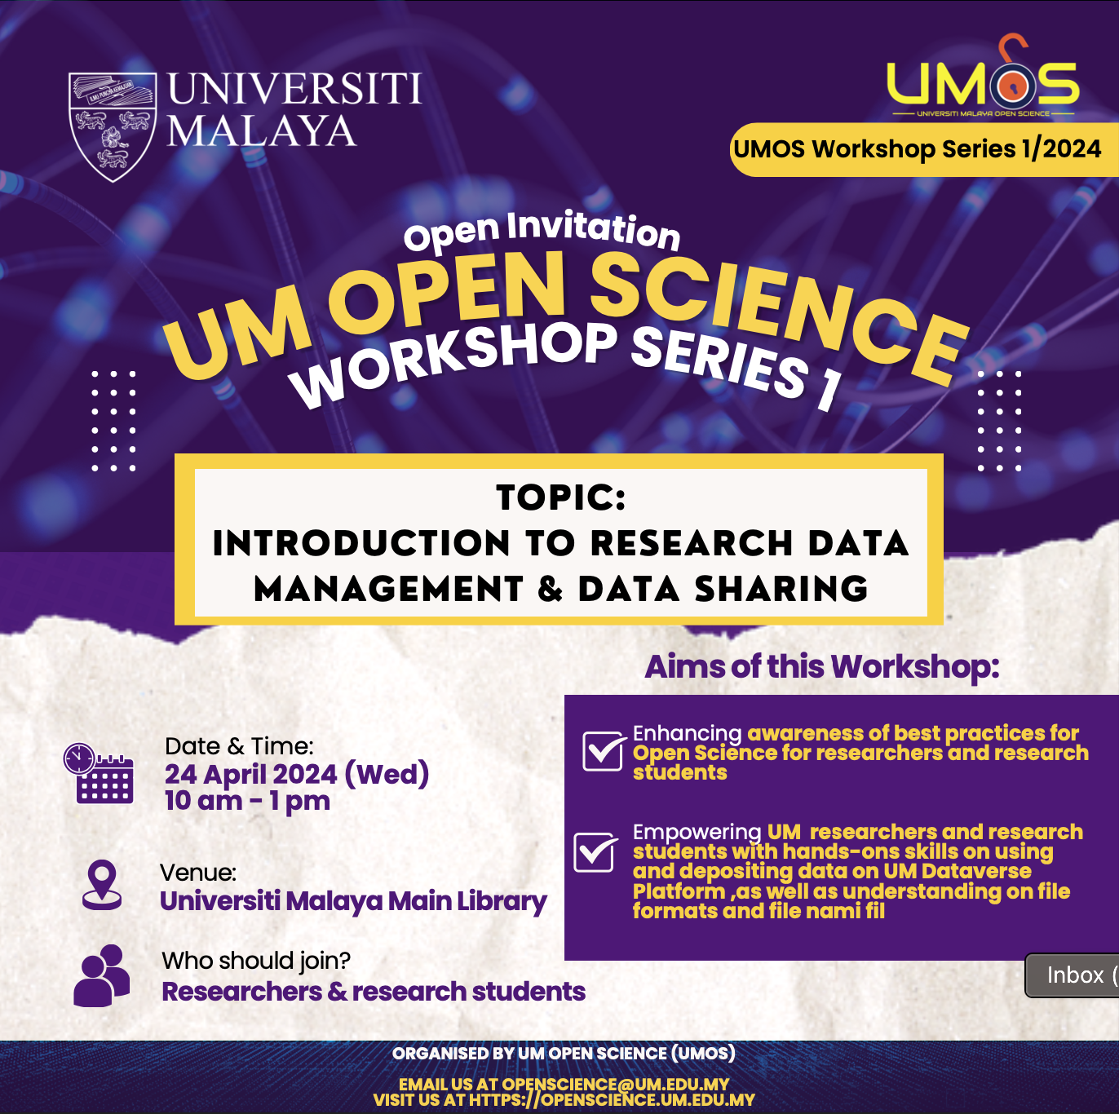
Capacity Building:
All UM researchers (academic staffs, research officers, research students)
UMOS organise physical and online trainings on topics related to:
Research Data Management
Developing a Data Management Plan
How to Deposit Research Data on UM Research Repository

Slide 12
Future Direction & Opportunities
Mandate open access science
Push for open data sharing
Enhanced research transparency & integrity
Innovation & societal impact
Foster and create incentives; develop systems to allay fears and reward openness
Merit affordable open access

Slide 13
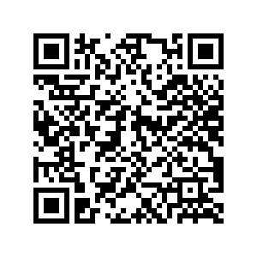
Thank you Email us: openscience@um.edu.my Visit us:https://openscience.um.edu.my/
Scan to download
UMOS Brochure

